Slide 1
The Aggregate Demand curve is downward sloping because of:
Real Balances (or wealth) Effect | Interest Rate Effect | Foreign purchases effect
Classify the following statements according to which theory in the chart above they describe.
People need more cash which they withdraw from their bank accounts. This leaves banks with less money to lend
When American products are expensive foreigners won’t buy them
Interest rates go up leading to less investment spending
Higher prices reduces purchasing power
When Amperican products are expensive Americans will buy foreign products.
When prices rise spending is reduced

Slide 2
The Aggregate Demand curve is downward sloping because of:
Real Balances (or wealth) Effect | Interest Rate Effect | Foreign purchases effect
Higher prices reduces purchasing power When prices rise spending is reduced | People need more cash which they withdraw from their bank accounts. This leaves banks with less money to lend Interest rates go up leading to less investment spending | When American products are expensive Americans will buy foreign products When American products are expensive foreigners won’t buy them

Slide 3
The Determinants of AD and SRAS cause the curve to shift
Input Prices
Prices of Resources
Productivity
Wages
Determinants of AD
Determinants of SRAS
Change in Consumer Spending – C
Change in the price of inputs
Change in price level
Change in Investment Spending – Ig
Change in productivity
Change in wages
Change in Government Spending - G
Net exports – X-M
Classify the Economic situations to the right as either Determinants of aggregate demand or determinants of short run aggregate supply.

Slide 4
The Determinants of AD and SRAS cause the curve to shift
Input Prices
Prices of Resources
Productivity
Wages
Determinants of SRAS
Determinants of AD
Consumer Spending – C
Investment Spending – Ig
Government Spending - G
Net exports – X-M
Input Prices
Prices of resources
Productivity
Wages
Change in Price level is not one of the determinants of AD or SRAS --- it will cause a movement along the curve not a shift.

Slide 5
Draw AD/AS graphs in equilibrium and than make the shift to show Demand Shocks
 | Negative Demand Shock | Positive Demand Shock
Draw and graph that shows the change indicated
Will the shock cause price to increase or decrease?
Will the shock cause GDP to increase or decrease?

Slide 6
Demand Shocks
 | Negative Demand Shock | Positive Demand Shock
Draw and graph that shows the change indicated
Will the shock cause price to increase or decrease? | Decrease | Increase
Will the shock cause GDP to increase or decrease? | Decrease | Increase
LRAS
LRAS
SRAS
Price Level
SRAS
Price Level
P1
P2
P2
P1
AD2
AD2
AD1
AD1
Y2
Y1
Real GDP
Y1
Y2
Real GDP

Slide 7
Draw AD/AS graphs in equilibrium and than make the shift to show Supply Shocks
 | Negative Supply Shock | Positive Supply Shock
Draw and graph that shows the change indicated
Will the shock cause price to increase or decrease?
Will the shock cause GDP to increase or decrease?

Slide 8
Supply Shocks
 | Negative Supply Shock | Positive Supply Shock
Draw and graph that shows the change indicated
Will the shock cause price to increase or decrease? | Increase | Decrease
Will the shock cause GDP to increase or decrease? | Decrease | Increase
LRAS
SRAS2
LRAS
SRAS1
Price Level
SRAS1
Price Level
SRAS2
P2
P1
P1
P2
AD
AD
Y2
Y1
Real GDP
Y1
Y2
Real GDP

Slide 9
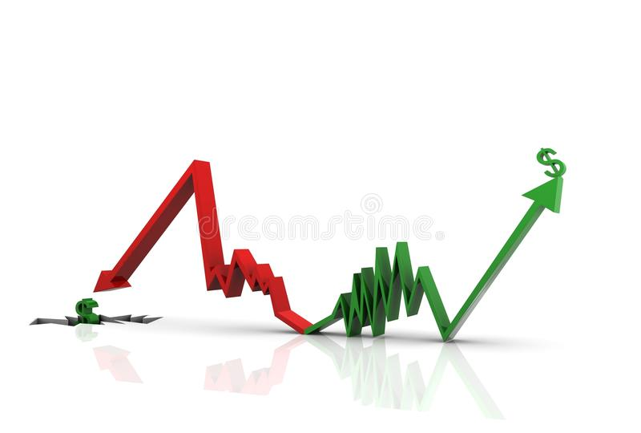
Draw two AD/AS graphs. On one illustrate a recessionary gap. On the other illustrate an inflationary gap.

Slide 10
Inflationary Gap
Recessionary Gap
LRAS
Price Level
LRAS
SRAS
SRAS
Price Level
Pe
Pe
AD
AD
Ye
Real GDP
Y1
Ye
Real GDP
Inflationary Gap
RecessionaryGap

