Slide 1
VII. Aggregate demand
adjective
adjective: aggregate
1.
formed or calculated by the combination of many separate units or items; total.

Slide 2
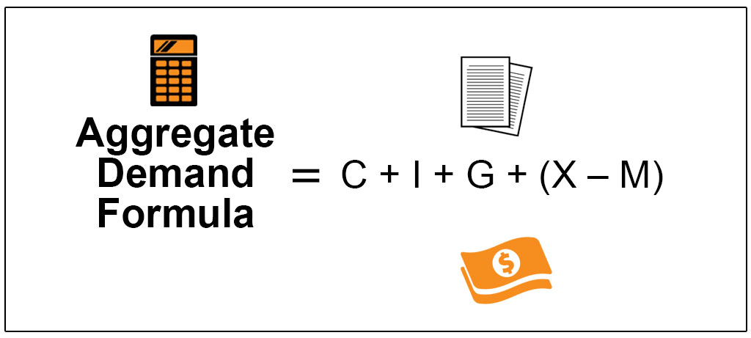

Slide 3
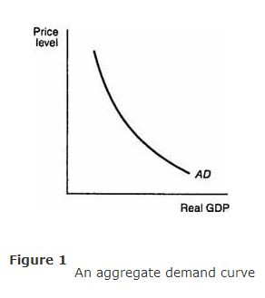
VII. Aggregate demand
A. The amounts of real output that buyers collectively desire to purchase at every possible price.

Slide 4
VII. Aggregate demand
A. The amounts of real output that buyers collectively desire to purchase at every possible price.
B. Slope is NOT a consequence of the law of demand
1. simple demand curve represents only ONE good
2. when the price of that ONE good goes up people switch to a substitute.
3. Switch to a substitute does not change Aggregate Demand since TOTAL spending remains
the same

Slide 5
C. Aggregate Demand Curve is downward sloping showing an
inverse relationship between price and GDP --- three causes
1. Real balances effect (wealth effect)
a. a higher price level reduces purchasing power
b. the public is poorer in real terms
c. spending is reduced

Slide 6
Downward slope is caused by 3 things
1. Real balances effect (wealth effect)
2. Interest Rate Effect
a. people need more money
b. public increases cash holdings
c. reduces funds available for others to borrow
d. interest rates go up
1. Reduces investment spending

Slide 7
C. Downward slope is caused by 3 things
1. Real balances effect (wealth effect)
2. Interest Rate Effect
3. Foreign purchases effect
a. U.S. prices rise compared to foreign prices
b. foreigners buy fewer U.S. goods
c. Americans buy more foreign goods

Slide 8
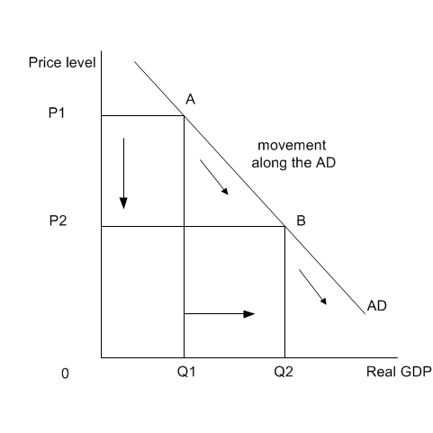
D. Movement along the AD curve
1. caused by a change in price level
2. movements along a fixed aggregate demand curve represent changes in real GDP

Slide 9
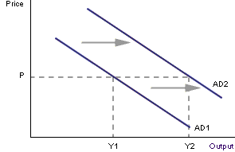
E. Shift in the curve or demand shock
Rightward shift shows increase in AD
Price
level
Real GDP

Slide 10
E. Shift in the curve or demand shock
Rightward shift shows increase in AD
Leftward shift shows decrease in AD
Price
level
Price
level
AD1
AD2
Real GDP

Slide 11
Remember this formula?
Instead of X – M we used Xn
The same formula works for AD
AD = C + I + G + Xn
When part of the formula changes the curve will shift

Slide 12
E. Shift in the curve or demand shock
Rightward shift shows increase in AD
Leftward shift shows decrease in AD
Shifts caused by a change in the determinants of AD
a. Consumer spending - C
1. Consumer wealth - increase in wealth causes increase in spending
2. Taxes – cut in taxes means more DI and more spending

Slide 13
Investment spending – Ig
Interest rates – increase in interest rates
lowers spending
Government Spending - G
d. Net export spending - Xn
1. National income abroad – foreigners making more money will buy American goods
Exchange rates – if the dollar depreciates – a lower value of dollars means foreigners get more dollars
when they exchange their currency – encourages
them to buy American products

Slide 14
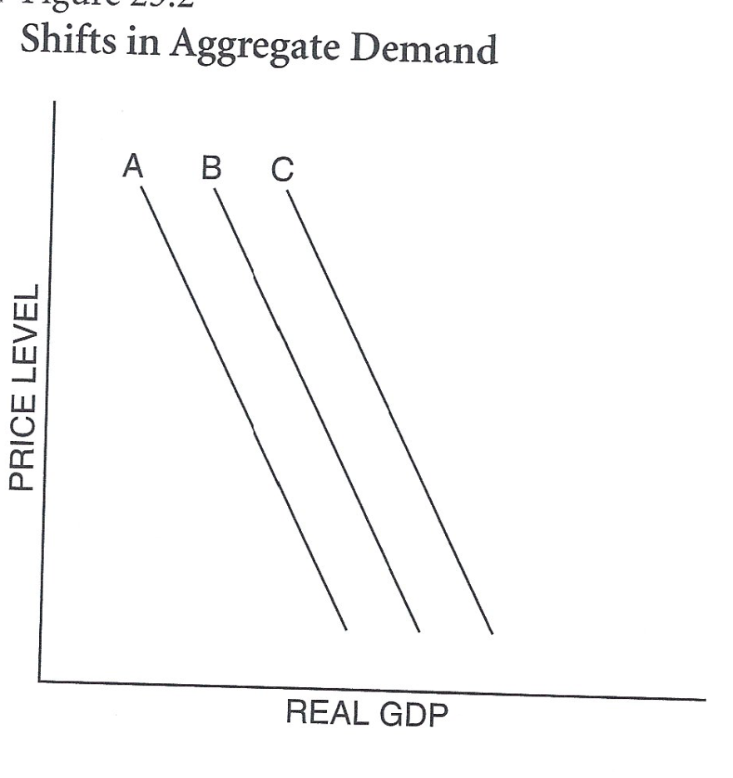
You Decide
In each situation decide if the action will cause an increase, decrease or no change in AD.
Always start at curve B and determine which curve (if any) will be the new demand curve

Slide 15
Congress cuts taxes
AD
New curve - C
Remember the formula AD = C+I+G+Xn

Slide 16
Investment spending decreased
AD
New curve - A
Remember the formula AD = C+I+G+Xn

Slide 17
Government spending increases
AD
New curve - C
Remember the formula AD = C+I+G+Xn

Slide 18
Stock market collapses; investors lose billions
AD
New curve - A
Remember the formula AD = C+I+G+Xn

Slide 19
Going on to Aggregate Supply

Slide 20
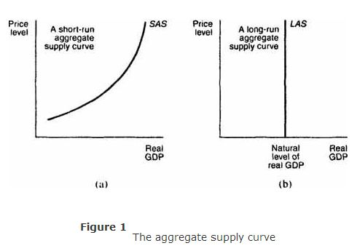
VIII. Aggregate Supply
Shows the level of real domestic output firms will produce at each price level
SRAS curve is upward sloping showing a positive relationship between price and output
SRAS
SRAS

Slide 21
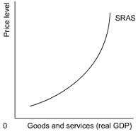
Short Run Curve
1. costs of production are fixed in the short run
a. Wages are biggest production cost
b. Wages are inflexible or “sticky”
As price rises producers produce more
a. BECAUSE Price – cost = profit
b. Increased price means increased profit

Slide 22
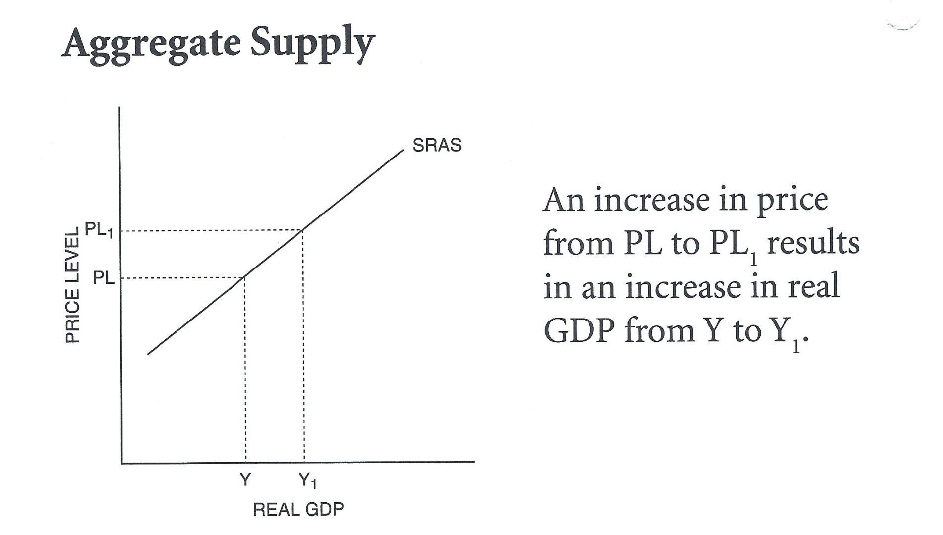
3. Movement along the curve caused by change in price level

Slide 23
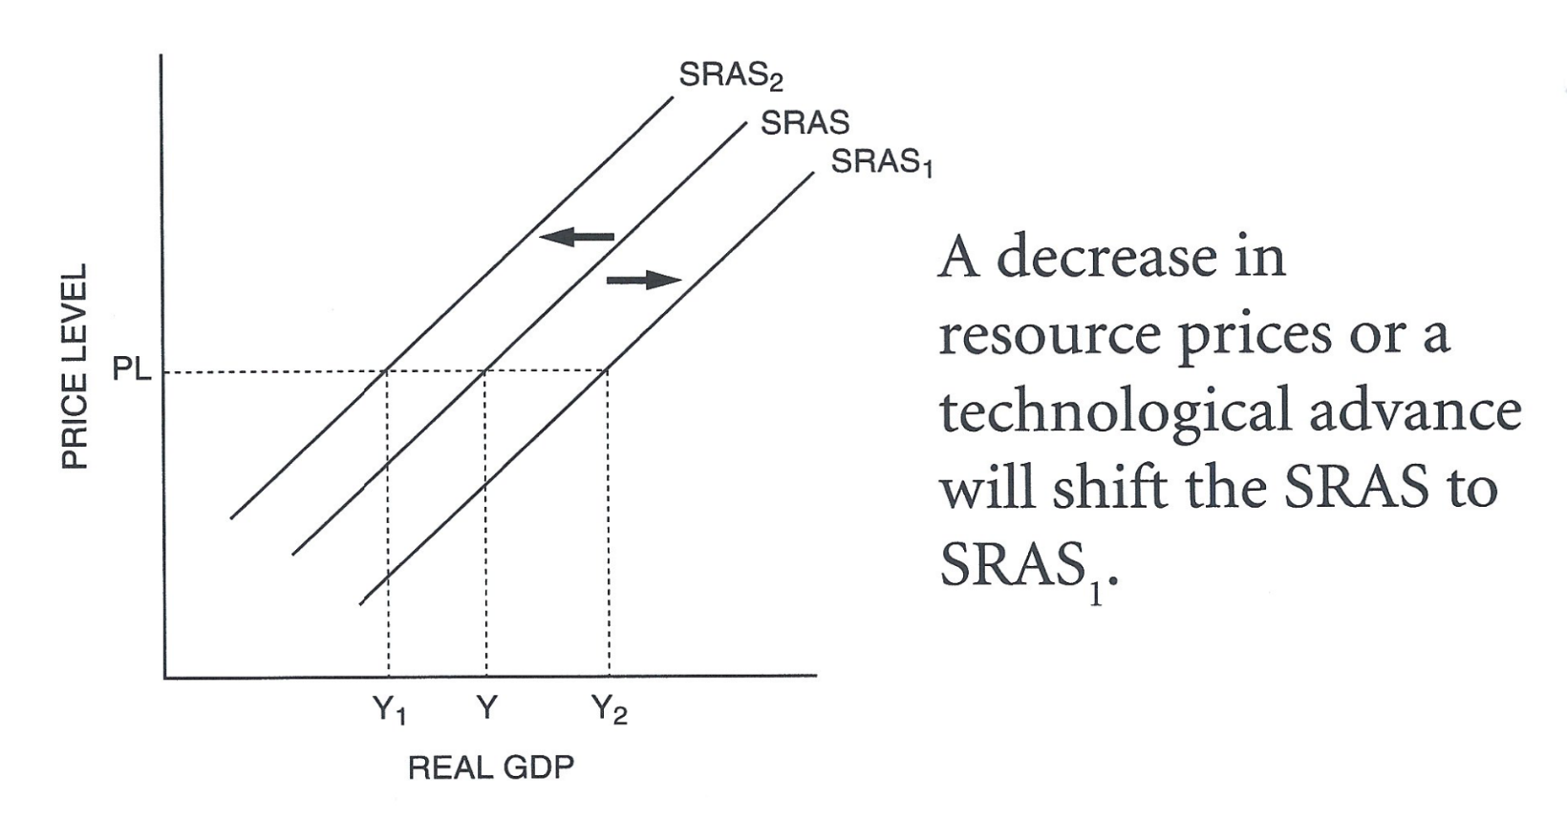
4. Shift in the curve or Supply Shock
Leftward shift – decrease in SRAS
Rightward Shift – increase in SRAS
Changes in factors other than price shift curve
Change in input
a. price of resources
b. wages
Changes in productivity

Slide 25
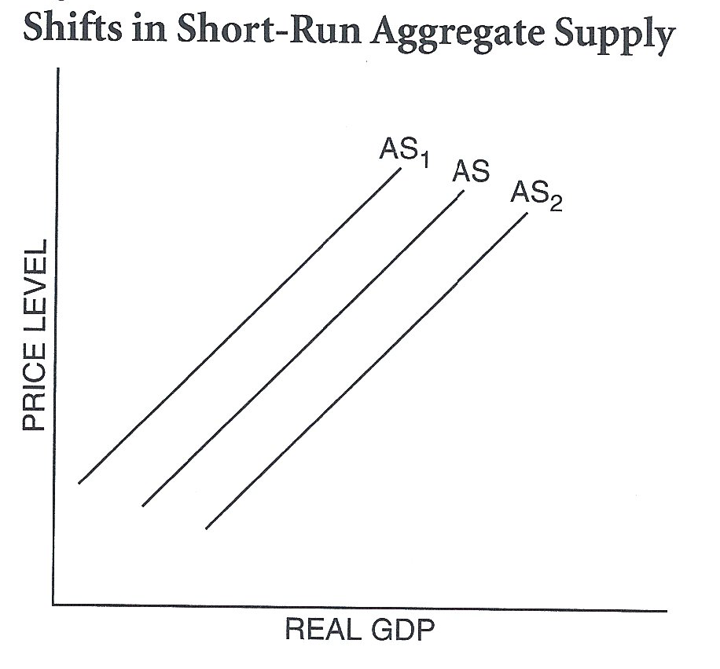
You Decide!
Based on the situation decide:
Which component of AS is affected
Input prices OR
productivity
Will AS increase or decrease
Which curve will the economy be at after the shift

Slide 26
Unions are effective so wages increase
What determinant is affected?
Input
AS will
Resulting curve
AS1
or Productivity

Slide 27
OPEC successfully increases oil prices
What determinant is affected?
Input
AS will
Resulting curve
AS1
or Productivity

Slide 28
Computer technology brings new efficiency to industry
What determinant is affected?
Productivity
AS will
Resulting curve
AS2
Input or

Slide 29
Improved schools have increased the skills of American workers
What determinant is affected?
Productivity
AS will
Resulting curve
AS2
Input or

Slide 30
Start working on your Homework in BLEND

