Slide 1
Absolute and Comparative Advantage
A. Absolute advantage
B. Comparative advantage
C. Trade

Slide 2
60 second preview of absolute and comparative advantage
https://www.youtube.com/watch?v=U12yZXBmQmY

Slide 3
Absolute and Comparative Advantabe
A. Absolute Advantage
1. the ability to produce more of something with
a given amount of time and resources.
We we are best friends Susie and Tommy and we are going to teach you about absolute and comparative advantage.

Slide 4
Let’s look at example of absolute advantage using snack foods as an example.
I like to snack on M&Ms and goldfish
Me too!!

Slide 5
Susie’s Production Possibilities Curve
Tommy’s Production Possibilities Curve
50
M&Ms
15
M&Ms
15 goldfish
25 goldfish
Susie
Who has absolute advantage in M&Ms?
Who has absolute advantage in goldfish?
Susie
I can make 50 M&Ms or 25 goldfish
I can make 15 M&Ms or 15 goldfish

Slide 6
Susie’s Production Possibilities Curve
Tommy’s Production Possibilities Curve
50
M&Ms
15
M&Ms
15 goldfish
25 goldfish
I have an absolute advantage in both M&Ms and Goldfish

Slide 7
Comparative Advantage and Trade
A. Absolute Advantage
B. Comparative Advantage
1. the ability to produce something at a lower
opportunity cost than someone else
2. not the same as absolute advantage

Slide 8
Susie’s Production Possibilities Curve
Tommy’s Production Possibilities Curve
50
M&Ms
15
M&Ms
15 goldfish
25 goldfish
FIRST – you need to calculate opportunity cost.
What is the opportunity cost of 1 M&M?

Slide 9
Susie’s Production Possibilities Curve
Tommy’s Production Possibilities Curve
50
M&Ms
15
M&Ms
15 goldfish
25 goldfish
To calculate opportunity cost put the other product over the one you are calculating opportunity cost for then reduce the fraction.
What is the opportunity cost of 1 M&M?
Goldfish = 25 = 1 SO 1 M&M = 1 goldfish
M&M 50 2 2

Slide 10
Susie’s Production Possibilities Curve
Tommy’s Production Possibilities Curve
50
M&Ms
15
M&Ms
15 goldfish
25 goldfish
To calculate opportunity cost put the other product over the one you are calculating opportunity cost for then reduce the fraction.
What is the opportunity cost of 1 goldfish?
_M&M_ = 50 = 2 SO 1 goldfish = 2 M&M
goldfish 25

Slide 11
Susie’s Production Possibilities Curve
Tommy’s Production Possibilities Curve
50
M&Ms
15
M&Ms
15 goldfish
25 goldfish
What is the opportunity cost of 1 M&Ms?
goldfish = 15 = 1 goldfish
M&M 15
What is the opportunity cost of 1 goldfish?
_M&M_ = 15 = 1 M&M
goldfish 15
To calculate opportunity cost put the other product over the one you are calculating opportunity cost for then reduce the fraction.

Slide 12
Susie’s Production Possibilities Curve
Tommy’s Production Possibilities Curve
50
M&Ms
15
M&Ms
15 goldfish
25 goldfish
 | Suzie’s Opportunity Cost | Tommy’s Opportunity Cost
1 M&M
1 goldfish
1/2 goldfish
1 goldfish
2 M&Ms
1 M&M

Slide 13
To determine comparative advantage look at opportunity cost.
The person with the lowest opportunity cost has the comparative advantage.
Who has the comparative advantage in M&Ms?
Who gives up the LEAST goldfish to make M&Ms?
Susie
Who has the comparative advantage in goldfish?
Who gives up the LEAST M&Ms to make goldfish?
Tommy
 | Suzie’s Opportunity Cost | Tommy’s Opportunity Cost
1 M&M
1 goldfish
1/2 goldfish
1 goldfish
2 M&Ms
1 M&M

Slide 14
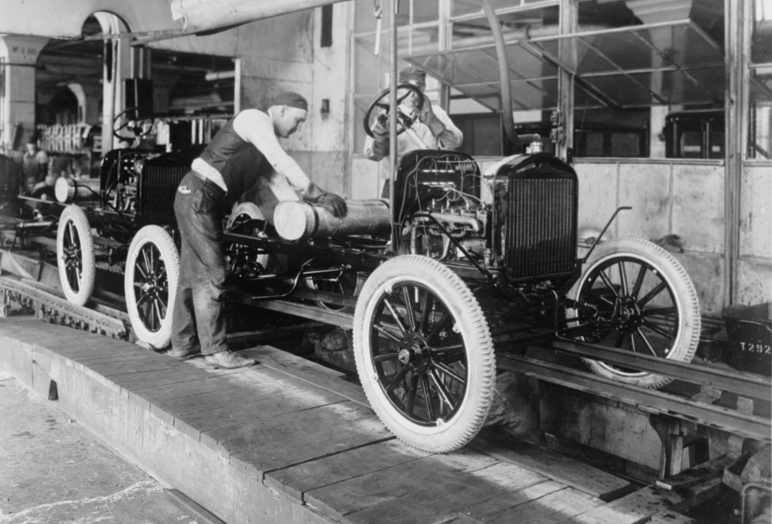
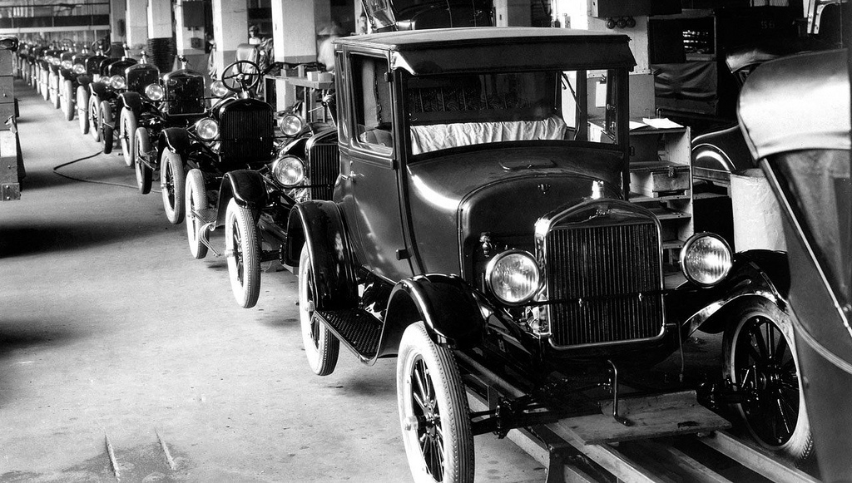
Comparative Advantage and Trade
C. Trade
1. Specialization – each person engages in a
different tasks
2. Gains from trade – dividing tasks
(specializing) and trading benefits both parties

Slide 15
Back to our snack example!

Slide 16
Susie’s Production Possibilities Curve
Tommy’s Production Possibilities Curve
50
M&Ms
15
M&Ms
40
15 goldfish
5
25 goldfish
I’m going to make 40 M&Ms and 5 goldfish
How many total snacks does Suzie have?
45

Slide 17
Susie’s Production Possibilities Curve
Tommy’s Production Possibilities Curve
50
M&Ms
15
M&Ms
40
7
8
15 goldfish
5
25 goldfish
I’m going to make 7 M&Ms and 8 goldfish
How many total snacks does Tommy have?
15

Slide 18
Susie’s Production Possibilities Curve
Tommy’s Production Possibilities Curve
50
M&Ms
15
M&Ms
15 goldfish
25 goldfish
You should specialize in the area where you have a comparative advantage and trade

Slide 19
Susie’s Production Possibilities Curve
Tommy’s Production Possibilities Curve
50
M&Ms
15
M&Ms
40
7
8
15 goldfish
5
25 goldfish
 | Production | Consumption | Traded
Goldfish
M&M
Goldfish
M&M
7
50
40
10
15
8
7
10

Slide 20
Susie’s Production Possibilities Curve
Tommy’s Production Possibilities Curve
50
M&Ms
15
M&Ms
40
7
8
15 goldfish
5
25 goldfish
How many snacks did each person gain?
 | Production | Consumption | Traded
Goldfish |  | 7
M&M | 50 | 40 | 10
Goldfish | 15 | 8 | 7
M&M |  | 10
+2
+3

Slide 21
Watch an example of comparative advantage.
https://www.youtube.com/watch?v=jNESLIbM8Ns

Slide 22
Comparative Advantage and Trade with Bert and Ernie

Slide 23
Comparative Advantage and Trade with Bert and Ernie
Suppose that Bert and Ernie both produce apples and bananas from their available resources but they do not currently trade with one another. The table below gives the number of hours of labor needed to produce one apple or one banana.
 | Hours of labor needed to produce one apple | Hours of labor needed to produce one banana
Bert | 2 | 4
Ernie | 3 | 1.5
Suppose Bert and Ernie have 120 hours of labor time. What is the maximum number of apples and bananas they can produce?
 | Apples produced in 120 hours | Bananas produced in 120 hours
Bert
Ernie
Sketch a production possibility curve for Bert and Ernie showing how much fruit they can produce?
Bert’s Production Possibility Curve
Ernie’s Production Possibility Curve
If you would like a hard copy of the Bert and Ernie example to work with you can print this slide.
Who has the absolute advantage in apples?
Who has the absolute advantage in bananas?
Determine the per unit opportunity cost.
 | Apples | Bananas
Bert | 1 apple = | 1 banana =
Ernie | 1 apple = | 1 banana =
Who has the comparative advantage in apples?
Who has the comparative advantage in bananas?
Bert will specialize in apples and Ernie will specialize in bananas and they will trade.
How many bananas must Bert get per apple to make the trade worthwhile?
How many apples must Ernie get per banana to make the trade worthwhile?
Is a 1 for 1 trade profitable for both Burt and Ernie?

Slide 24
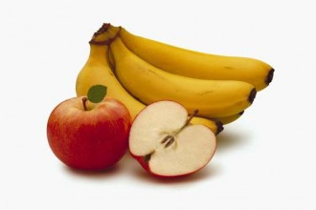
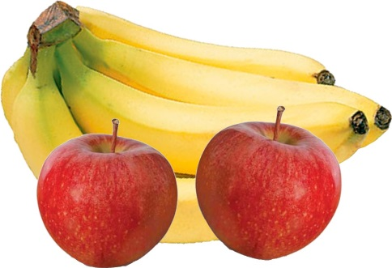
Suppose that Bert and Ernie both produce apples and bananas from their available resources but they do not currently trade with one another. The table below gives the number of hours of labor needed to produce one apple or one banana.
NOTICE the information you have is about productivity --- you need to convert this into OUTPUT
 | Hours of labor needed to produce one apple | Hours of labor needed to produce one banana
Bert | 2 | 4
Ernie | 3 | 1.5

Slide 25
Suppose Bert and Ernie have 120 hours of labor time. What is the maximum number of apples and bananas they can produce?
 | Hours of labor needed to produce one apple | Hours of labor needed to produce one banana
Bert | 2 | 4
Ernie | 3 | 1.5
 | Apples produced in 120 hours | Bananas produced in 120 hours
Bert
Ernie

Slide 26
Suppose Bert and Ernie have 120 hours of labor time. What is the maximum number of apples and bananas they can produce?
 | Hours of labor needed to produce one apple | Hours of labor needed to produce one banana
Bert | 2 | 4
Ernie | 3 | 1.5
 | Apples produced in 120 hours | Bananas produced in 120 hours
Bert
Ernie
120/2 = 60 apples
120/4 = 30 bananas
120/3 = 40 apples
120/1.5 = 80 bananas

Slide 27
Sketch a production possibility curve for Bert and Ernie showing how much fruit they can produce? Assume a constant opportunity cost.
 | Apples produced in 120 hours | Bananas produced in 120 hours
Bert | 60 | 30
Ernie | 40 | 80
Bert’s Production Possibility Curve
Ernie’s Production Possibility Curve
apples
apples
50
40
30
20
10
50
40
30
20
10
10 20 30 40 50 60 70 80
bananas
10 20 30 40 50 60 70 80
bananas

Slide 28
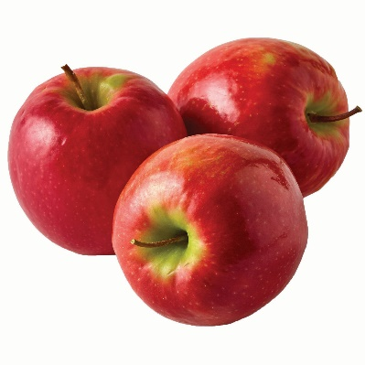
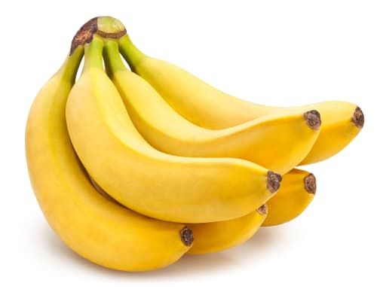
Who has the absolute advantage in apples?
Who has the absolute advantage in bananas?
Bert
Ernie
Bert’s Production Possibility Curve
Ernie’s Production Possibility Curve
apples
apples
50
40
30
20
10
50
40
30
20
10
10 20 30 40 50 60 70 80
bananas
10 20 30 40 50 60 70 80
bananas

Slide 29
Determine the per unit opportunity cost.
 | Apples produced in 120 hours | Bananas produced in 120 hours
Bert | 60 | 30
Ernie | 40 | 80
 | Apples | Bananas
Bert | 1 apple = ? | 1 banana = ?
Ernie | 1 apple = ? | 1 banana = ?
Remember – the other product goes over the one you are determining opportunity cost for.

Slide 30
Determine the per unit opportunity cost.
 | Apples produced in 120 hours | Bananas produced in 120 hours
Bert | 60 | 30
Ernie | 40 | 80
 | Apples | Bananas
Bert | 1 apple = | 1 banana =
Ernie | 1 apple = | 1 banana =
30/60 = ½ banana
60/30 = 2 apples
80/40 = 2 bananas
40/80 = ½ apple
Who has the comparative advantage in apples?
Who has the comparative advantage in bananas?
Bert – Bert only give up 1/2 a banana for each apple where Ernie gives up 2
Ernie – Ernie only gives up ½ an apple for each banana where Bert gives up 2

Slide 31
Terms of Trade
 | Apples | Bananas
Bert | 1 apple = ½ banana | 1 banana = 2 apples
Ernie | 1 apple = 2 bananas | 1 banana = ½ apple
Bert will specialize in apples and Ernie will specialize in bananas and they will trade.
How many bananas must Bert get per apple to make the trade worthwhile?
½ banana – you must get AT LEAST your opportunity cost
How many apples must Ernie get per banana to make the trade worthwhile?
½ apple – you must get at least your opportunity cost
Is a 1 for 1 trade profitable for both Bert and Ernie?
YES

Slide 32
Watch Mr. Clifford solve a problem.
https://www.youtube.com/watch?v=36pT8GLp0tc

Slide 33
Comparative Advantage in The Hunger Games
https://www.youtube.com/watch?v=tzXzkAs_cf0

Slide 34
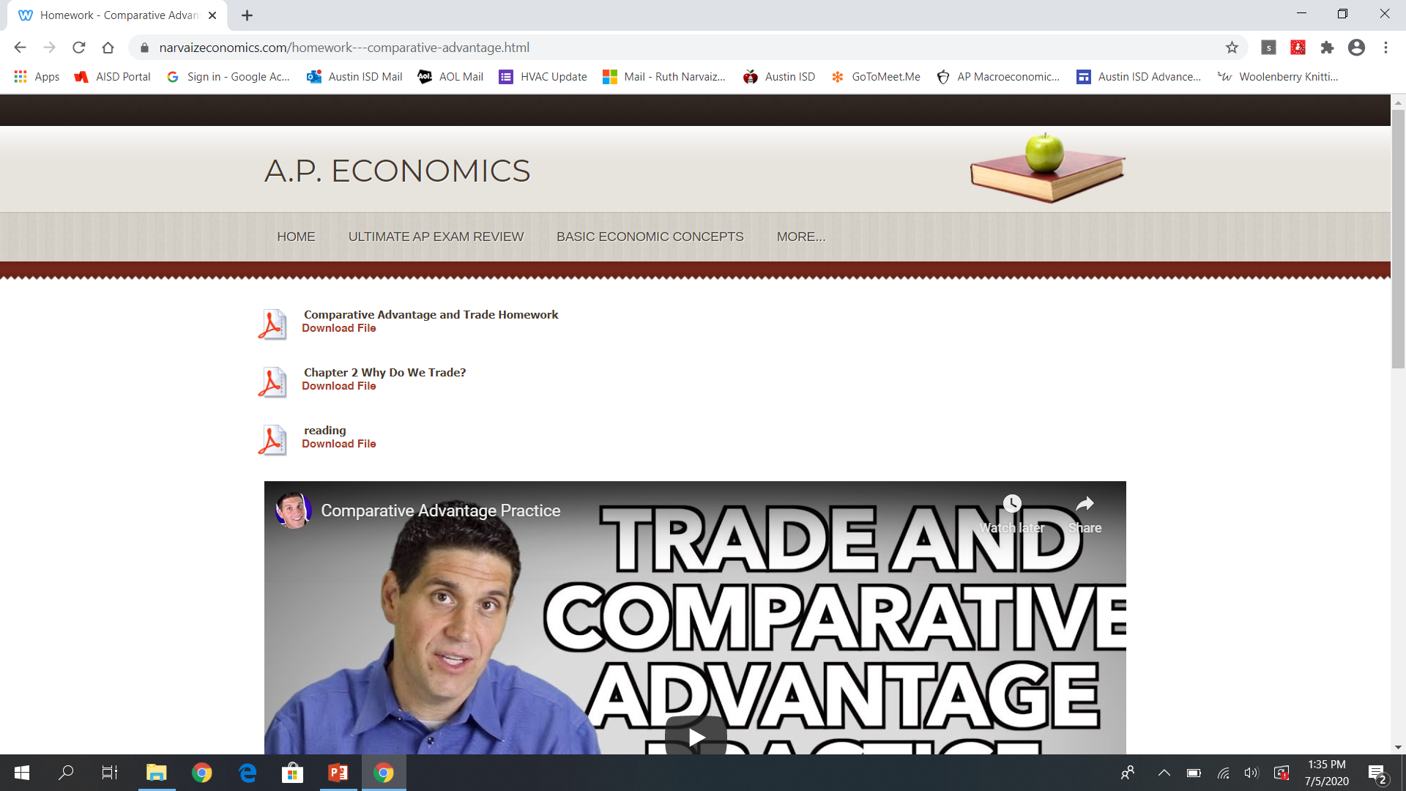
You are now ready to do your comparative advantage homework.
DO YOUR HOMEWORK

