Slide 1
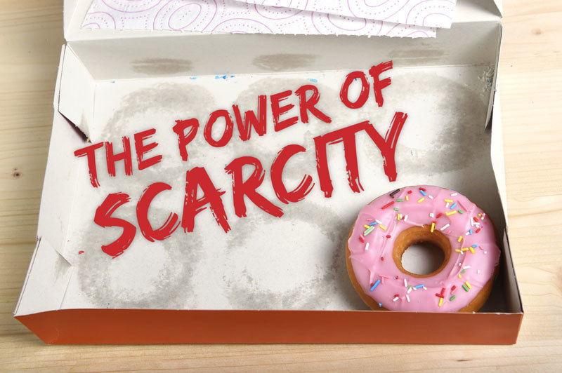

Slide 2
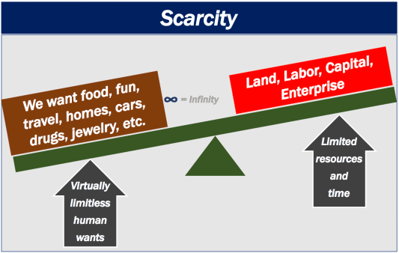
Scarcity
Society has unlimited wants
Economic resources are scarce

Slide 3
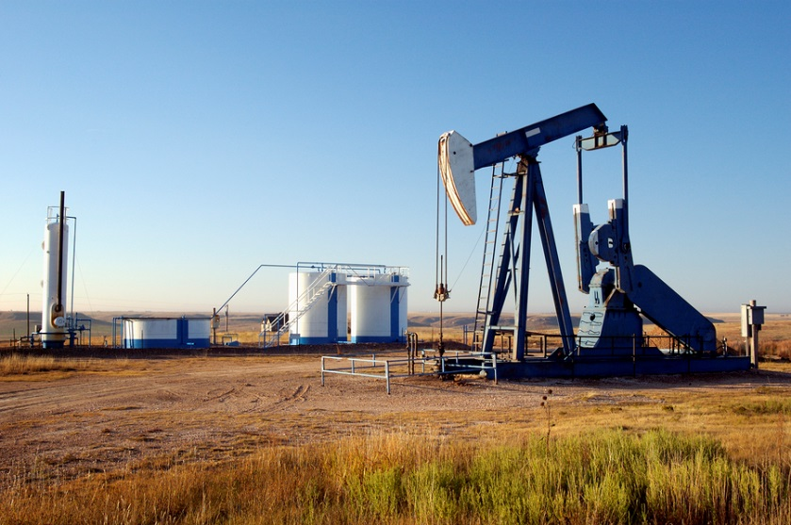
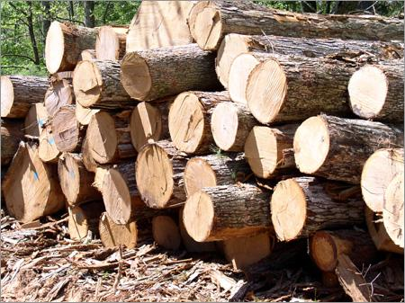
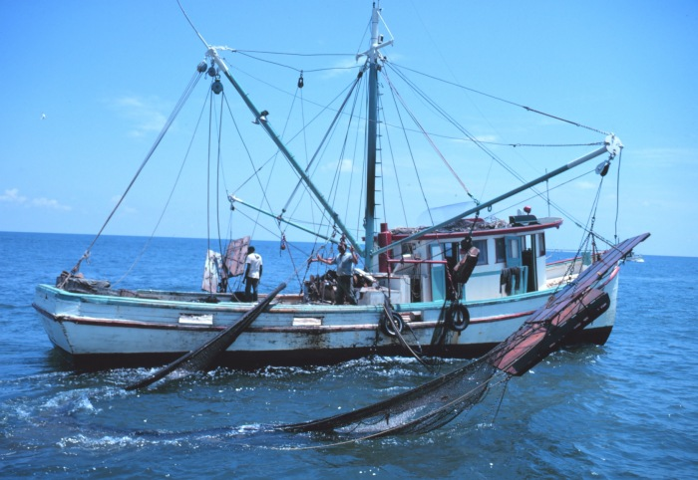
C. Economic Resources (factors of production) include:
1. land – all gifts of nature

Slide 4
C. Economic Resources (factors of production) include:
1. land – all gifts of nature
2. Labor – all physical and mental talents

Slide 5
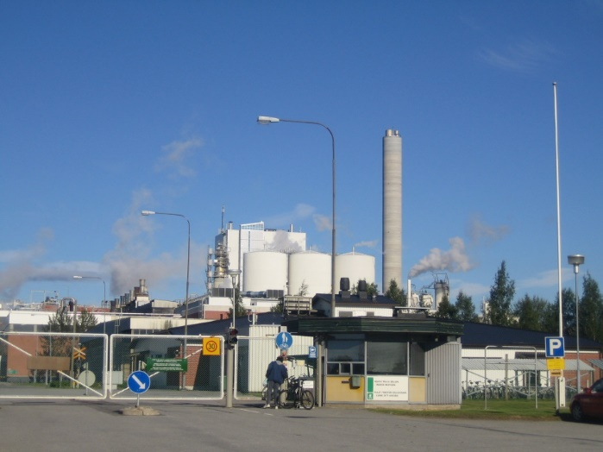
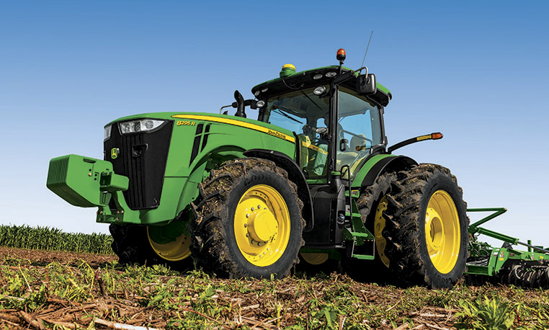
C. Economic Resources (factors of production) include:
1. land – all gifts of nature
2. Labor – all physical and mental talents
3. Capital – manufactured aids used in producing
goods and services

Slide 6
C. Economic Resources (factors of production) include:
1. land – all gifts of nature
2. Labor – all physical and mental talents
3. Capital – manufactured aids used in producing
goods and services
4. Entrepreneurial ability – takes initiative and risk

Slide 7
Labor
Land
Capital
Entrepreneur
Complete this Kahoot as a review!
https://kahoot.it/challenge/08482440?challenge-id=656b9424-a7e1-404f-a793-17b932e0d60f_1598386822407
To play in class
https://play.kahoot.it/v2/?quizId=63905c5a-bb9e-4a1e-81f1-49dc1798fcc2

Slide 8
D. Scarcity requires choice

Slide 9
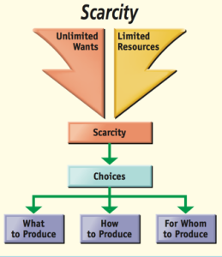
D. Scarcity requires choice
1. Three economic questions
a. WHAT to produce
b. HOW to produce it
c. WHO receives the goods
2. In a market economy PRICE answers these questions

Slide 10
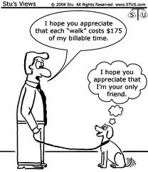
E. Opportunity Cost
1. what must be given up in order to get something
What is the opportunity cost of walking the dog?
$175

Slide 11
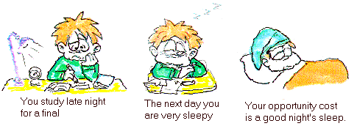
E. Opportunity Cost
1. what must be given up in order to get something.
Opportunity costs are not necessarily monetary;

Slide 12
Opportunity Cost
Let’s practice.
For each of the following situations describe the opportunity cost of each decision.

Slide 13
James is given a choice for his next holiday from school:
he can be an unpaid intern at a company
OR
he can earn $2,000 working as a camp counselor.
He decides to take the internship.
The opportunity cost is the $2,000 in salary that James gave up

Slide 14
James is given a choice for his next holiday from school:
he can be an unpaid intern at a company
OR
he can earn $2,000 working as a camp counselor.
If he takes the camp counselor job what is the opportunity cost?
The experience of the internship

Slide 15
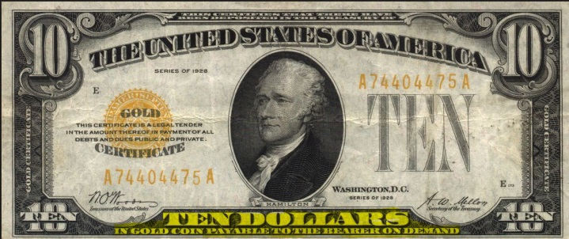
Sarah considers two options for Saturday night:
she can attend a concert that costs $10 per ticket
OR
she can go to the free movie offered at the student union.
She decides to attend the concert.
There are two opportunity costs --- depending on which you think is the next best option
Attending the movie
Whatever she could have purchased with the $10

Slide 16
A new business in town debates paying $20,000 for a prime location
OR
$10,000 for a less perfect location.
The business estimates that it will eventually serve the same number of customers in either location, but that it will take 6 months before the sub optimal location provides the same outcome as the prime location.
The business decides to purchase the $10,000 property.
The $10,000 property is not the opportunity cost – the business MUST have a location to exist.
The opportunity cost is the additional business it would have gotten at the prime location during the first six months.

Slide 17
Roberto is studying for two midterms this week. He figures he has 20 available hours to study for both midterms.
If he studies all 20 hours for the economics exam he will undoubtedly make an A on the exam but will at best earn a C on his chemistry exam.
OR
If he studies all 20 hours for the chemistry test he will get an A on the chemistry exam, but will likely earn a D on his economics test.
Roberto decide to devote all of his available time to economics since he has determined that he does not wish to pursue a premed major.
The opportunity cost is the higher grade in Chemistry

Slide 18
The following table presents the possible combinations of study time available to Roberto this week as he prepares for his two midterms. Assume Roberto has 20 hours available to study
Hours of study time spent on Economics | Hours of study time spent on chemistry | Grade in economics | Grade in Chemistry
0 | 20 | 60 | 90
5 | 15 | 70 | 85
10 | 10 | 80 | 75
15 | 5 | 86 | 73
20 | 0 | 90 | 70
Roberto currently plans to study 10 hours for economics and 10 hours for chemistry.
BUT
If he alters his plan and studies 15 hours for economics, what is the opportunity cost of that decision?
Two points in Chemistry

Slide 19
Hours of study time spent on Economics | Hours of study time spent on chemistry | Grade in economics | Grade in Chemistry
0 | 20 | 60 | 90
5 | 15 | 70 | 85
10 | 10 | 80 | 75
15 | 5 | 86 | 73
20 | 0 | 90 | 70
Roberto currently plans to study 10 hours for economics and 10 hours for chemistry.
BUT
If he alters his plan and studies 15 hours for chemistry, what is the opportunity cost of that decision?
Ten points in Economics

Slide 20
Hours of study time spent on Economics | Hours of study time spent on chemistry | Grade in economics | Grade in Chemistry
0 | 20 | 60 | 90
5 | 15 | 70 | 85
10 | 10 | 80 | 75
15 | 5 | 86 | 73
20 | 0 | 90 | 70
Roberto currently plans to study 10 hours for economics and 10 hours for chemistry.
BUT
If he alters his plan and studies 20 hours for economics, what is the opportunity cost of that decision?
Five points in Chemistry

Slide 21
Hours of study time spent on Economics | Hours of study time spent on chemistry | Grade in economics | Grade in Chemistry
0 | 20 | 60 | 90
5 | 15 | 70 | 85
10 | 10 | 80 | 75
15 | 5 | 86 | 73
20 | 0 | 90 | 70
Roberto currently plans to study 10 hours for economics and 10 hours for chemistry.
BUT
If he alters his plan and studies 20 hours for chemistry, what is the opportunity cost of that decision?
Twenty points in Economics

Slide 22
Production Possibilities Curve

Slide 23
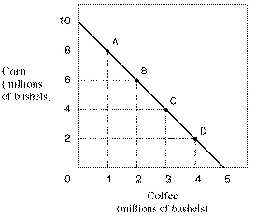
F. Production Possibilities Model -
Graphic representation of opportunity cost
2. Each point on the curve represents some
maximum output of two products

Slide 24
Can you read the graph?
If I produce 3 million bushels of coffee how much corn will I be able to produce?
4 million bushels
If I produce 10 million bushels of corn how much coffee will I be able to produce?
None

Slide 25
F. Production Possibilities Model -
Graphic representation of opportunity cost
Each point represents some maximum output of two
products
3. Assumptions:
All resources are being used
Technology is fixed
4. Because of the assumptions:
Points outside the curve are not attainable
Points inside the curve are not efficient

Slide 26
Opportunity Cost
This graph demonstrates opportunity cost by showing how much coffee must be given up to get corn (and vice versa)
What is the opportunity cost of one million additional bushels of coffee?
2 million bushels of corn
What is the opportunity cost of one million additional bushels of Corn?
½ million bushels of coffee

Slide 27
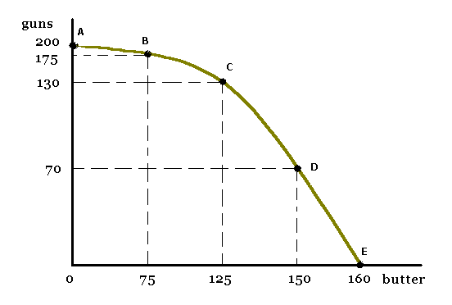
5. Law of increasing opportunity cost –
a. the more of a product that is produced, the greater its opportunity cost
b. Shape of the curve illustrates the law
Guns and butter is a classic economics comparison. Guns represent capital goods and butter represents consumer goods.

Slide 28
Can you read the graph?
If the economy is producing 150 units of butter how many guns can be produced?
70
If the economy is producing 130 guns how much butter can be produced?
125

Slide 29
Because not all resources are equally suited to making both guns and butter the trade off is not always equal.
If the economy is producing 160 units of butter, what is the opportunity cost of producing the first 70 guns?
10 units of butter

Slide 30
Because not all resources are equally suited to making both guns and butter the trade off is not always equal.
If the economy is producing 175 guns what is the opportunity cost of adding an addition 25 guns?
75 units of butter

Slide 31
So
The first 70 guns “cost” 10 units of butter
The last 25 guns “cost” 75 units of butter

Slide 32
NOW – Watch me explain the production possibilities curve! Click on the link to the right if you prefer to open a new window
https://www.youtube.com/watch?v=SJQ56vJoy3Y

Slide 33
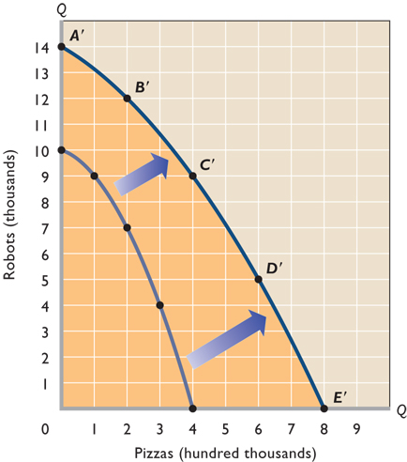
6. Production possibilities curve may shift if:
Increase in resources
Advances in technology

Slide 35
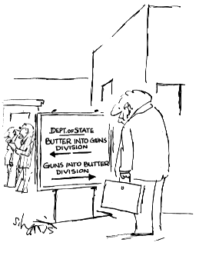
Production Possibilities Curve Practice

Slide 36
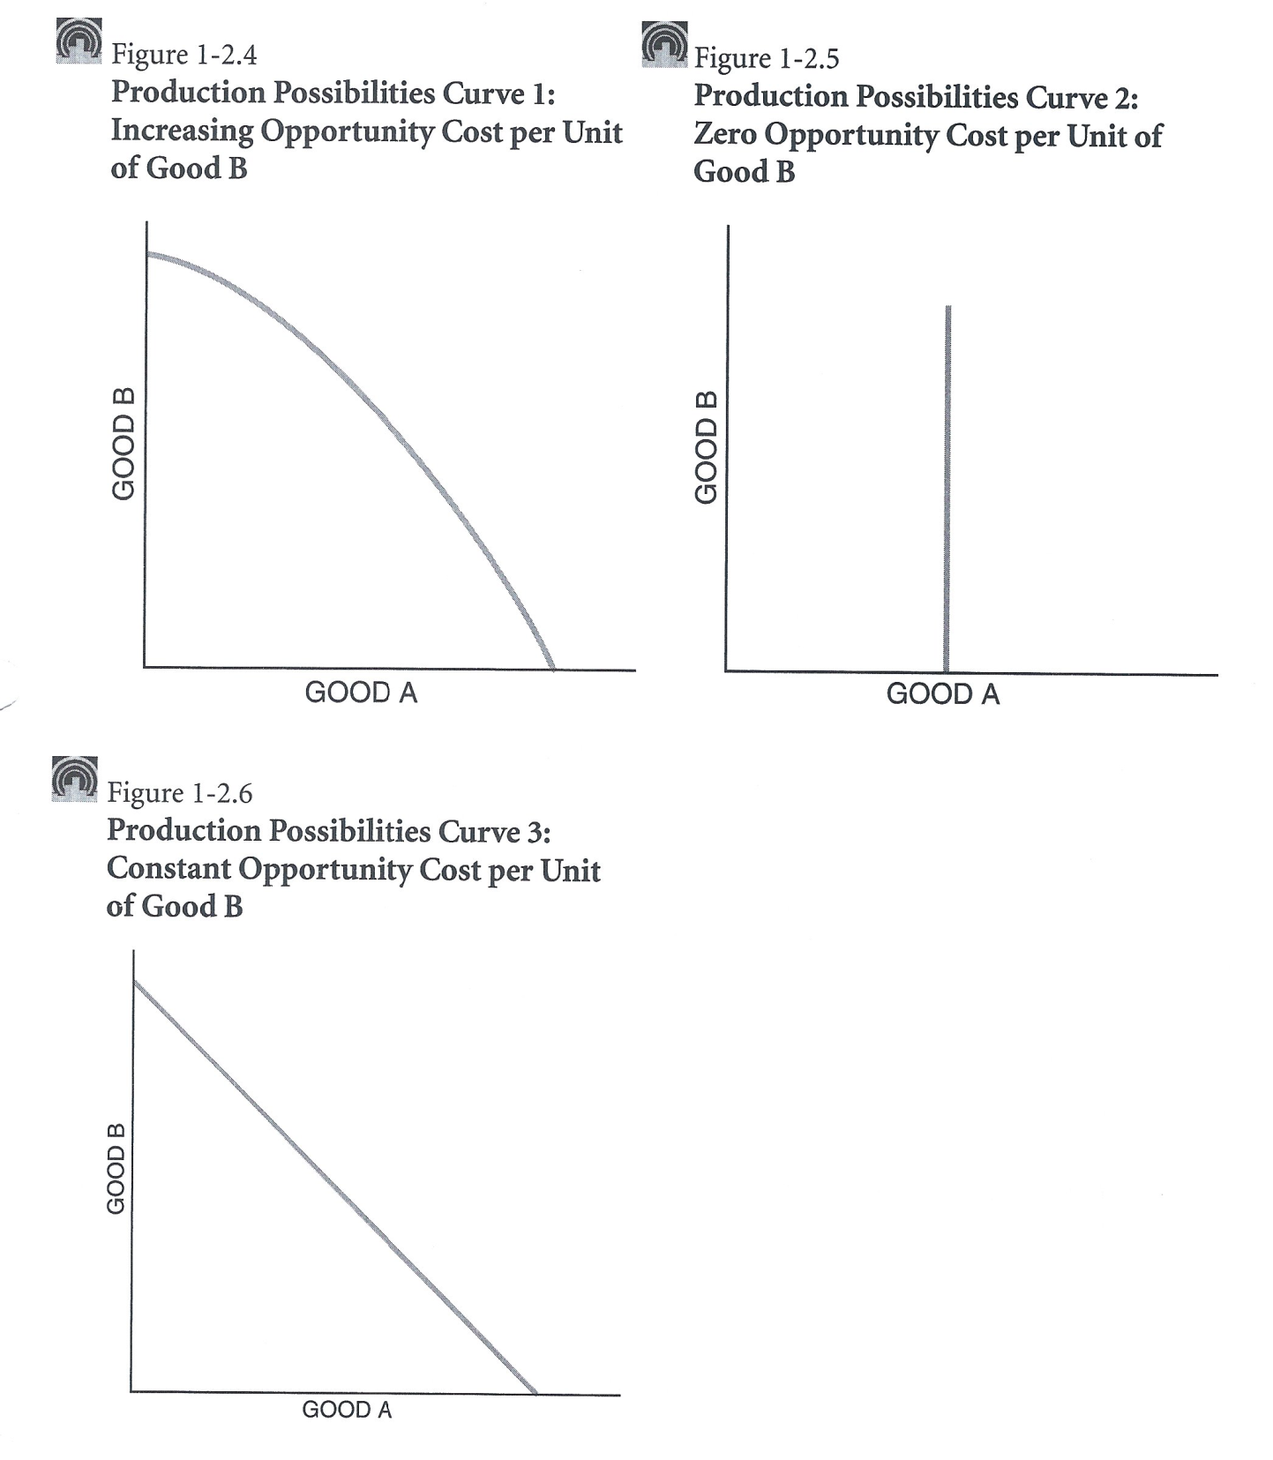
Increasing opportunity cost
Identify which curve has a constant opportunity cost and which has an increasing opporunity cost.
Constant opportunity cost

Slide 37
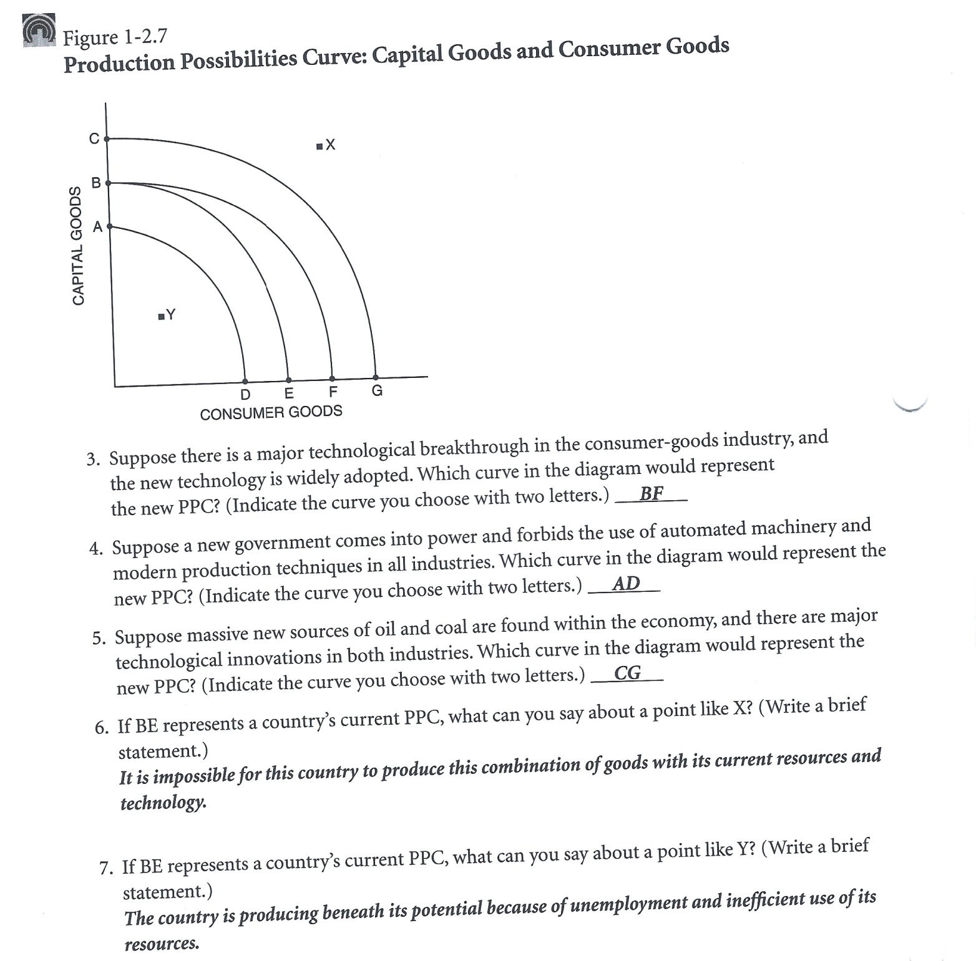
Assume that each questions starts with curve BE
Suppose there is a major technological breakthrough in the consumer good industry, and the new technology is widely adopted Which curve in the diagram would represent the new PPC?
BF
Suppose a new government comes to power and forbids the use of
automated machinery and modern production techniques in all
industries. Which curve in the diagram would represent the new PPC?
AD
Suppose massive new sources of oil and coal are found within the
economy, and there are major technological innovations in both
industries. Which curve in the diagram would represent the new PPC?
CG
If BE represents a country’s current PPC, what can you say about a point
like X?
unobtainable – not enough resources
If BE represents a country’s current PPC, what can you say about a point
like Y?
inefficient – not using all resources

Slide 38
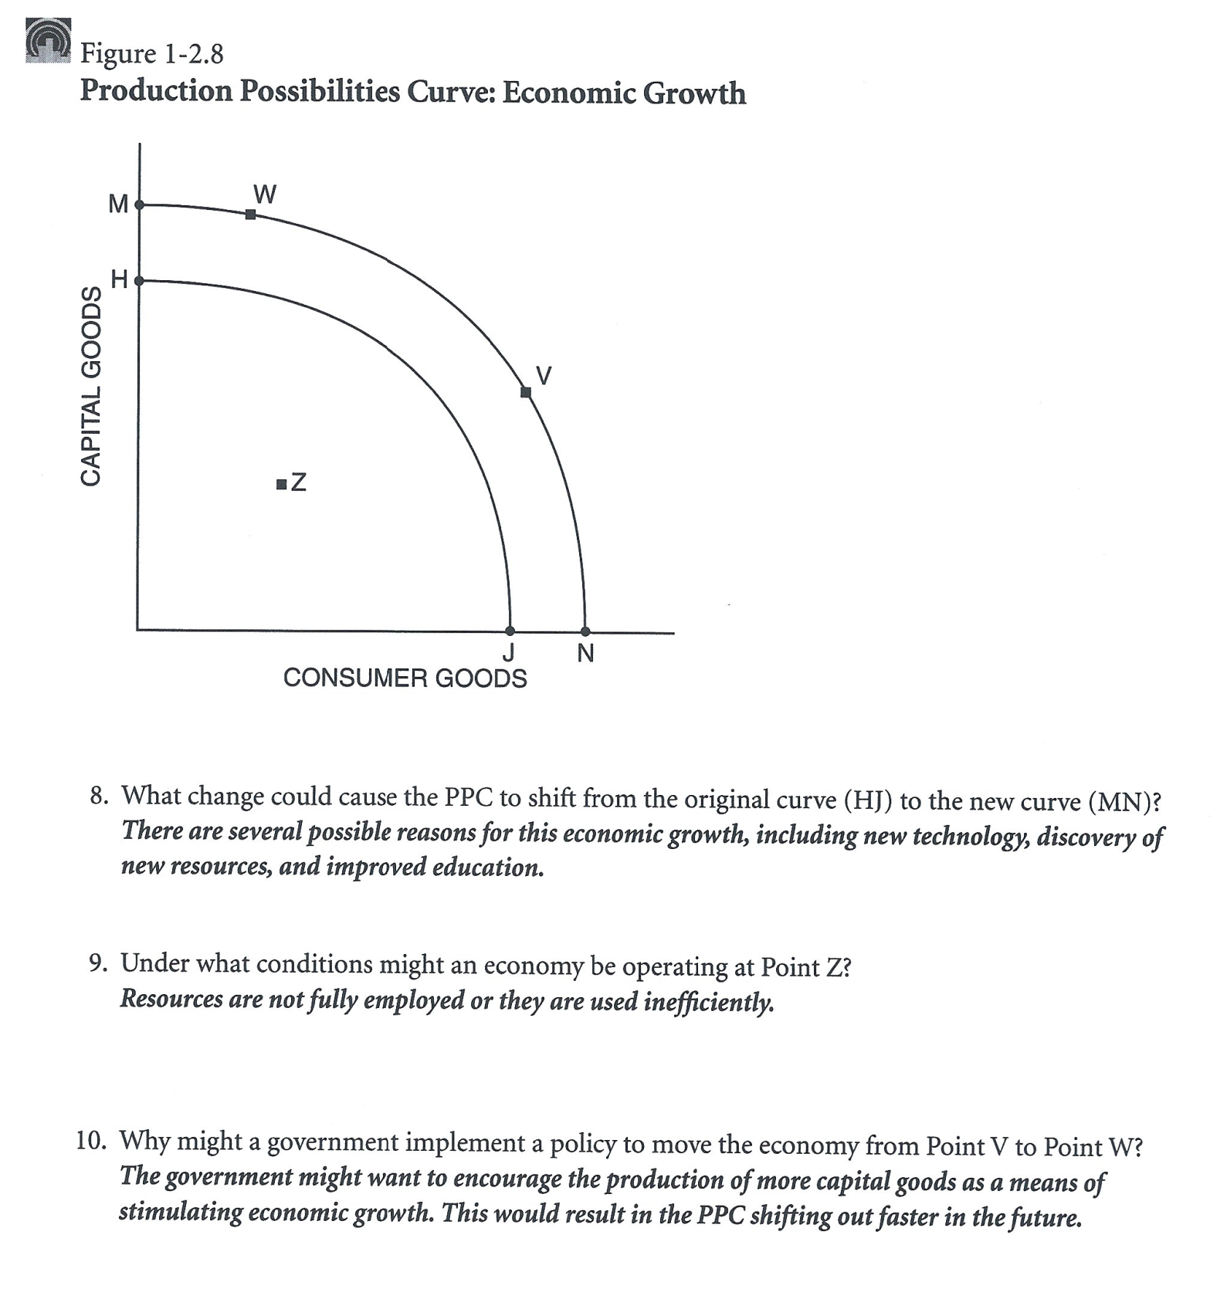
What change would cause the PPC to shift from the original curve (HJ) to the new curve (MN)?
New technology or new resources
Under what conditions might an economy be operating at point Z?
recession or depression – high unemployment
Why might a government implement a policy to move the economy from point V to point W?
preparing for war

Slide 39
https://www.youtube.com/watch?v=UYlBLw-ShIM
I can explain the PPC. Click on the link to the right if you prefer to open in a new window

