Slide 1
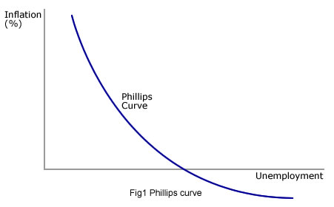
Inflation and Unemployment and the Phillips Curve

Slide 2
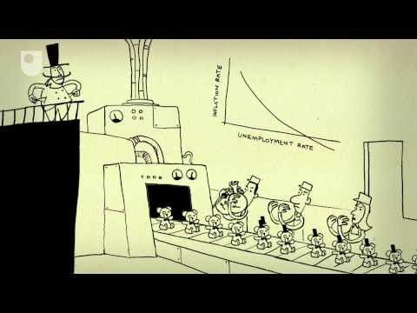

Slide 3
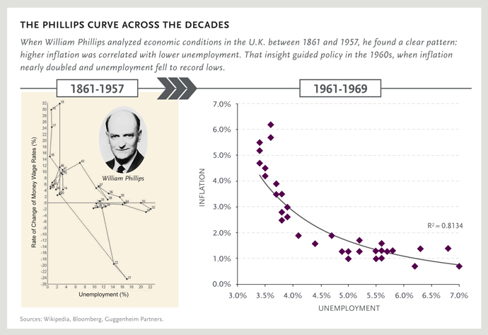

Slide 4
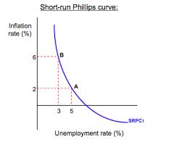
Short Run Phillips Curve
A. Inverse relationship between inflation and unemployment
1. Low unemployment leads to rising wages which leads to inflation
2. high unemployment leads to falling wages which keeps inflation low
B. SRPC is draw to a particular inflationary expectation

Slide 5
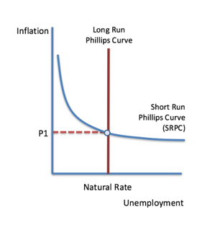
Long Run Phillips Curve
A in the long run there is no trade off between unemployment and inflation
B. The economy will adjust to the natural rate of unemployment
C. LRPC crosses SRPC where EXPECTED inflation is equal to
ACTUAL inflation

Slide 6
Shifting the Phillips Curve
A. LRPC - NEVER shift LRPC – it will always be at the natural rate of unemployment
B. SRPC
1. AD – if AD shifts there is movement along the SRPC

Slide 7
Decrease AD – shift left
Price Level
LRAS
inflation
LRPC
SRAS
PLe
A
A
AD
SRPC
Ye
Real GDP
unemployment

Slide 8
Decrease AD – shift left
Price Level
LRAS
inflation
LRPC
SRAS
PLe
A
A
PL1
B
AD1
AD
SRPC
Ye
Real GDP
Y1
unemployment

Slide 9
AD
Price
Output
Inflation
unemployment
Price Level
LRAS
inflation
LRPC
SRAS
PLe
A
A
B
PL1
B
AD1
AD
SRPC
Ye
Real GDP
Y1
unemployment

Slide 10
Increase AD – shift right
Price Level
LRAS
inflation
LRPC
SRAS
PLe
A
A
AD
SRPC
Ye
Y1
Real GDP
unemployment

Slide 11
Increase AD – shift right
Price Level
LRAS
inflation
LRPC
SRAS
B
PL1
PLe
A
A
AD1
AD
SRPC
Ye
Y1
Real GDP
unemployment

Slide 12
AD
Price
Output
This corresponds to
Inflation
unemployment
Price Level
LRAS
inflation
LRPC
SRAS
B
B
PL1
PLe
A
A
AD1
AD
SRPC
Ye
Y1
Real GDP
unemployment

Slide 13
Shifting the Phillips Curve
A. LRPC - NEVER shift LRPC – it will always be at the natural rate of unemployment
B. SRPC
1. AD – if AD shifts there is movement along the SRPC
2. SRAS – if SRAS shifts SRPC shifts

Slide 14
Decrease SRAS – shift left
Price Level
LRAS
inflation
LRPC
SRAS
PLe
A
A
AD
SRPC
Ye
Real GDP
unemployment

Slide 15
Decrease SRAS – shift left
Price Level
LRAS
inflation
LRPC
SRAS1
SRAS
B
PL1
PLe
A
A
AD
SRPC
Ye
Real GDP
Y1
unemployment

Slide 16
SRAS
Price
Output
Inflation
unemployment
Price Level
LRAS
inflation
LRPC
SRAS1
SRAS
B
B
PL1
PLe
A
A
SRPC1
AD
SRPC
Ye
Real GDP
Y1
unemployment

Slide 17
Increase SRAS – shift right
Price Level
LRAS
inflation
LRPC
SRAS
PLe
A
A
AD
SRPC
Ye
Real GDP
unemployment

Slide 18
Increase SRAS – shift right
Price Level
LRAS
inflation
LRPC
SRAS
SRAS1
PLe
A
A
PL1
B
AD
SRPC
Ye
Y1
Real GDP
unemployment

Slide 19
SRAS
Price
Output
Inflation
unemployment
Price Level
LRAS
inflation
LRPC
SRAS
SRAS1
PLe
A
A
B
PL1
B
AD
SRPC
SRPC1
Ye
Y1
Real GDP
unemployment

Slide 20
Shifting the Phillips Curve
A. LRPC - NEVER shift LRPC – it will always be at the natural rate of unemployment
B. SRPC
1. AD – if AD shifts there is movement along the SRPC
2. SRAS – if SRAS shifts SRPC shifts
3. Expectations - changes in the expected rate of inflation shift the SRPC
a. If prices are expected to rise
b. Workers will ask for higher wages to maintain purchasing power
c. Employers will be willing to pay if hiring workers in the future will be more expensive
d. Rising input prices means producers must raise prices

