Slide 1
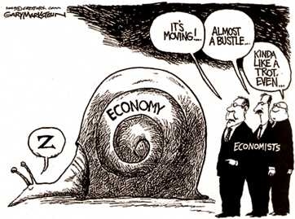
National Income and Price Determination

Slide 2
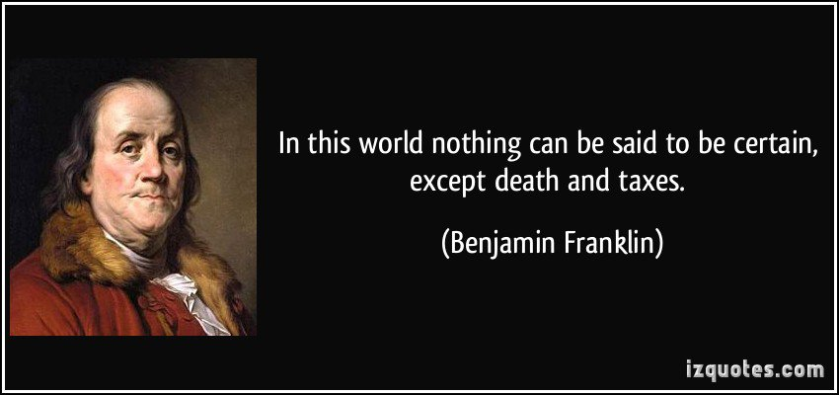
Disposable Income – DI

Slide 3
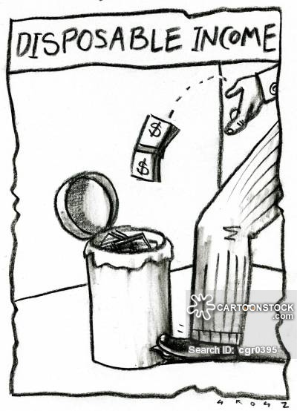
Disposable Income – DI
A. Personal income after taxes
B. Consumption + Savings = Disposable Income

Slide 4
Let’s work a sample problem
Consumption + Savings = Disposable Income
Year | DI | C | S
1 | $1000 | $1500
2 | 2000 | 2000
3 | 3000 | 2400
4 | 4000 | 3000
5 | 5000 | 3500
6 | 6000 | 3000
-500
0
600
1000
1500
3000

Slide 5
pro·pen·si·ty
prəˈpensətē/
noun
noun: propensity; plural noun: propensities
an inclination or natural tendency to behave in a particular way

Slide 6
Average Propensity to Consume
Percentage of disposable income that is consumed
APC =
III. Average Propensity to Save
Percentage of disposable income that is saved
APS =
APC + APS = 1
Consumption
Disposable income
savings
DI

Slide 7
Let’s work a sample problem
APC =
Consumption
DI
APC =
1,500
1,000
= 1.5
Year | DI | C | S | APC
1 | $1000 | $1500 | -500
2 | 2000 | 2000 | 0
3 | 3000 | 2400 | 600
4 | 4000 | 3000 | 1000
5 | 5000 | 3500 | 1500
6 | 6000 | 3000 | 3000
1.5
1
.8
.75
.7
.5

Slide 8
Let’s work a sample problem
Savings
DI
APS=
OR APC + APS = 1
-500
1,000
APS = 1.5 + X = 1
APS = -.5
APS =
= -.5
Year | DI | C | S | APC | APS
1 | $1000 | $1500 | -500 | 1.5
2 | 2000 | 2000 | 0 | 1
3 | 3000 | 2400 | 600 | .8
4 | 4000 | 3000 | 1000 | .75
5 | 5000 | 3500 | 1500 | .7
6 | 6000 | 3000 | 3000 | .5
-.5
0
.2
.25
.3
.5

Slide 9
Marginal Propensity to consume
A. Marginal = extra
B. proportion of any change in disposable income that is consumed
C. MPC = change in consumption
change in DI
V. Marginal Propensity to Save
A. proportion of any change in disposable income that is saved
B. MPS = change in saving
change in DI
C. MPC + MPS = 1

Slide 10
YEAR | DI Disposable Income | C Consumption | S Savings DI - C
1 | $0 | $80
2 | $100 | 140
3 | 200 | 200
4 | 300 | 260
5 | 400 | 320
-80
-40
0
40
80
Savings = DI - C

Slide 11
YEAR | DI Disposable Income | C Consumption | S Savings DI - C | Change in DI How much did DI change from previous year?
1 | $0 | $80 | -80
2 | $100 | 140 | -40
3 | 200 | 200 | 0
4 | 300 | 260 | 40
5 | 400 | 320 | 80
No previous year to compare
$100
$100
$100
$100
Change in DI
How much did DI go up from the previous year

Slide 12
YEAR | DI Disposable Income | C Consumption | S Savings DI - C | Change in DI How much did DI change from previous year? | Change in C How much did C change from previous year?
1 | $0 | $80 | -80
2 | $100 | 140 | -40 | $100
3 | 200 | 200 | 0 | $100
4 | 300 | 260 | 40 | $100
5 | 400 | 320 | 80 | $100
No previous year to compare
No previous year to compare
$60
$60
$60
$60
Change in C
How much did C go up from the previous year

Slide 13
YEAR | DI Disposable Income | C Consumption | S Savings DI - C | Change in DI How much did DI change from previous year? | Change in C How much did C change from previous year? | MPC
1 | $0 | $80 | -80
2 | $100 | 140 | -40 | $100
3 | 200 | 200 | 0 | $100
4 | 300 | 260 | 40 | $100
5 | 400 | 320 | 80 | $100
_ Consumption__
Disposable Income
No previous year to compare
No previous year to compare
No previous year to compare
$60
.6
$60
.6
$60
.6
$60
.6
MPC =
__Change in Consumption__
Change in Disposable Income
60
100
MPC =
= .6

Slide 14
YEAR | DI Disposable Income | C Consumption | S Savings DI - C | Change in DI How much did DI change from previous year? | Change in C How much did C change from previous year? | MPC | Change in S How much did S change from previous year?
1 | $0 | $80 | -80
2 | $100 | 140 | -40 | $100 | $60 | .6
3 | 200 | 200 | 0 | $100 | $60 | .6
4 | 300 | 260 | 40 | $100 | $60 | .6
5 | 400 | 320 | 80 | $100 | $60 | .6
_ Consumption__
Disposable Income
No previous year to compare
No previous year to compare
No previous year to compare
No previous year to compare
$40
$40
$40
$40
Change in S
How much did S go up from the previous year

Slide 15
YEAR | DI Disposable Income | C Consumption | S Savings DI - C | Change in DI | Change in C | MPC | Change in S How much did S change from previous year? | MPS
1 | $0 | $80 | -80
2 | $100 | 140 | -40 | $100 | $60 | .6 | $40
3 | 200 | 200 | 0 | $100 | $60 | .6 | $40
4 | 300 | 260 | 40 | $100 | $60 | .6 | $40
5 | 400 | 320 | 80 | $100 | $60 | .6 | $40
No previous year to compare
No previous year to compare
.4
.4
.4
.4
MPS =
____Change in Savings____
Change in Disposable Income
40
100
MPS =
= .4
MPS + MPC = 1

Slide 16
Time to Kahoot --- use the first link below to do the practice Kahoot yourself!
https://kahoot.it/challenge/05067539?challenge-id=656b9424-a7e1-404f-a793-17b932e0d60f_1603650380506
https://play.kahoot.it/#/?quizId=be0fab4a-c731-4bb2-aede-2f03dad0e504

Slide 17
VI. Multiplier
A small change in:
Consumption (C)
Investment spending (Ig)
Government purchases (G)
Net exports (Xn)
leads to an even bigger change in GDP

Slide 19
VI. Multiplier
A small change in
Investment spending
Consumption
Net exports
Government purchases
leads to an even bigger change in GDP
Multiplier determines how large the change will be
Multiplier =
Multiplier =
___1___
1 - MPC
_1__
MPS

Slide 20
Let’s review and go through an example -
Disposable Income
APC (as a % or fraction) -- The average of what people will _________
APS (as a % or fraction) -- The average of what people will _________
APC + APS will always = ______
consume.
save.
one

Slide 21
Marginal Analysis: What happens when a NEW unit is added?
consume.
MPC = What % of new DI people will ________
MPS = What % of new DI people will ________
MPC + MPS will always = ______
save.
one

Slide 22
Narvaizville gives all citizens a $1,000 tax cut!
MPC = .9 --- this means you will spend 90% of new money MPS = .1

Slide 23
Assume new marginal income is created – a $1000 tax cut SO – everyone has an extra $1000 of DI MPC = .9 --- this means you will spend 90% of new money MPS = .1
Person | $ Spent | $ Saved
First person to get the $1000

Slide 24
WOW! $1,000 How much will I spend?
MPC = .9 MPS = .1
Person | $ Spent | $ Saved
First person to get the $1000

Slide 25
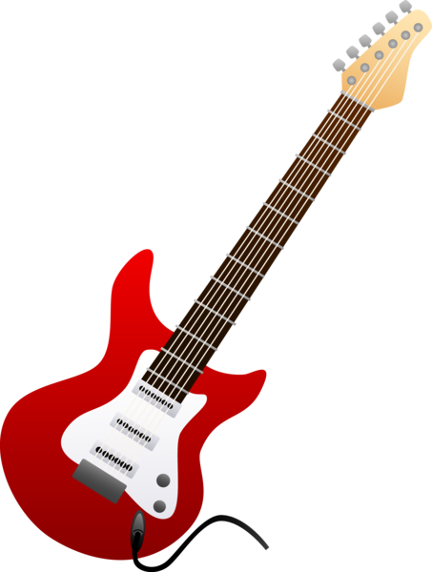
MPC = .9 MPS = .1
I’m going to buy that new $900 guitar I wanted and save the rest
Person | $ Spent | $ Saved
First person to get the $1000 | $900 | $100

Slide 26
MPC = .9 MPS = .1
I just sold a $900 guitar! What should I do with the money?
Person | $ Spent | $ Saved
First person to get the $1000 | $900 | $100
Second person gets $900

Slide 27
MPC = .9 MPS = .1
I’m going to buy my wife the diamond earrings she wanted.
Person | $ Spent | $ Saved
First person to get the $1000 | $900 | $100
Second person gets $900 | $810 | $90

Slide 28
MPC = .9 MPS = .1
How should I spend my extra cash?
Person | $ Spent | $ Saved
First person to get the $1000 | $900 | $100
Second person gets $900 | $810 | $90
Third person gets $810

Slide 29
MPC = .9 MPS = .1
Person | $ Spent | $ Saved
First person to get the $1000 | $900 | $100
Second person gets $900 | $810 | $90
Third person gets $810 | $729 | $81

Slide 30
MPC = .9 MPS = .1
Person | $ Spent | $ Saved
First person to get the $1000 | $900 | $100
Second person gets $900 | $810 | $90
Third person gets $810 | $729 | $81
Fourth person gets $729 | $656.10 | $72.90

Slide 31
MPC = .9 MPS = .1
Person | $ Spent | $ Saved
First person to get the $1000 | $900 | $100
Second person gets $900 | $810 | $90
Third person gets $810 | $729 | $81
Fourth person gets $729 | $656.10 | $72.90
Fifth person to gets $656.10 | $590.49 | $65.61
Total so far of the original $1000

Slide 32
MPC = .9 MPS = .1
Person | $ Spent | $ Saved
First person to get the $1000 | $900 | $100
Second person gets $900 | $810 | $90
Third person gets $810 | $729 | $81
Fourth person gets $729 | $656.10 | $72.90
Fifth person to gets $656.10 | $590.49 | $65.61
Total so far of the original $1000 | $3685.59 | $409.51

Slide 33
NOTICE
For each person getting $1,000, several consumption events will occur.
Consumption will continue until $ spent goes to 0.
The spending multiplier Formula is used to estimate the amount of money that is “created.”
__1__ _1_
1 – MPC MPS

Slide 34
THEREFORE . . .
If the MPC is .9, what is the MPS?
MPS = .1

Slide 35
THEREFORE . . .
If the MPC is .9, what is the multiplier?
MPS = .1
__1___ _1_
MPS .1
Multiplier =
=
= 10

Slide 36
THEREFORE . . .
How many new dollars of consumption will be created because of the $1,000 tax cut?
multiplier x initial spending event
10 x $900 = $9,000 total addition to GDP

Slide 37
What if the MPC is .5?
If the MPC is only .5 what is the MPS?
MPS = .5

Slide 38
What if the MPC is .5?
If the MPC is only .5 what is the multiplier?
MPS = .5
__1___ _1_
MPS .5
Multiplier =
=
= 2

Slide 39
What if the MPC is .5?
How many new dollars of consumption will be created if government increases it’s spending by $1000.
multiplier x initial spending event
2 x $1000 = $2000 total addition to GDP

Slide 40
Time for Practice and Homework

