Slide 1
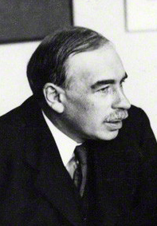
John Maynard Keynes
British economist
worked to explain the causes of business cycles,
widely considered to be one of the founders of modern macroeconomics
Considered most influential economist of the 20th century.

Slide 2
Before Keynes it was widely believed that government should not interfere in the economy

Slide 3
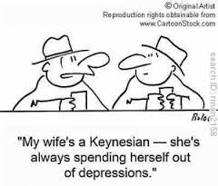
Keynes taught that:
inadequate aggregate demand led to periods of high unemployment.
state intervention was necessary to moderate "boom and bust" cycles of economic activity.
the use of fiscal policy will ease the adverse effects of economic recessions and depressions.

Slide 4
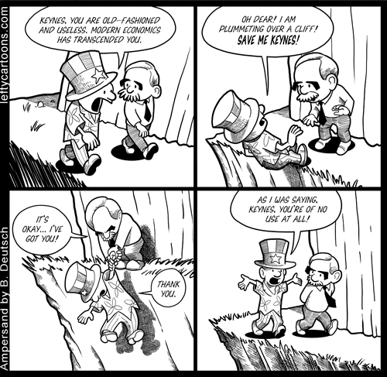
Some now question Keynesian ideas even though they are still in use

Slide 5
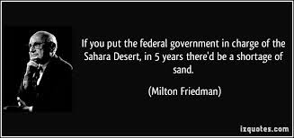
Not everyone is a fan of government intervention in the economy

