Slide 1
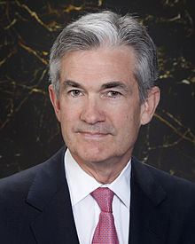
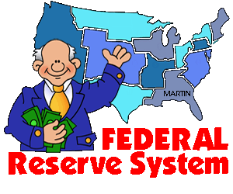
Chairman Jerome Powell

Slide 2
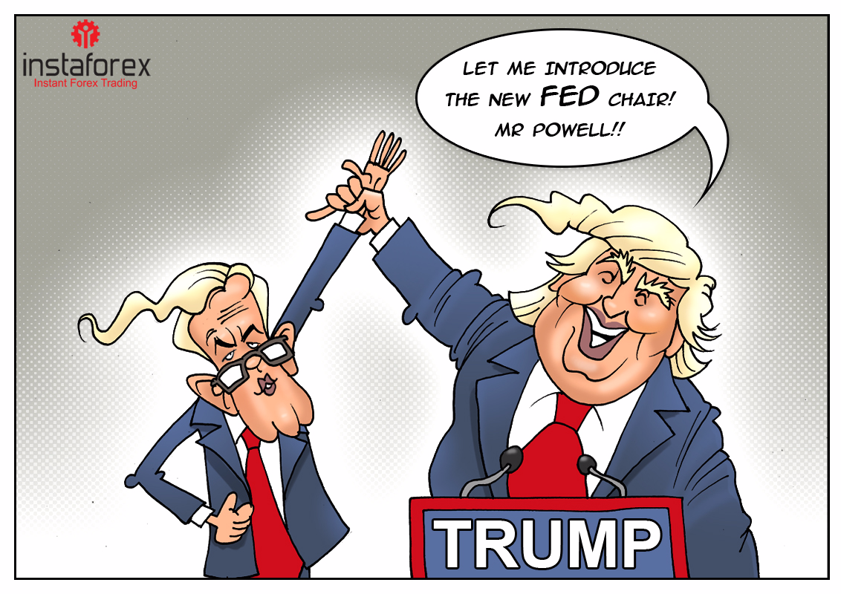
Trump's stamp on the Fed

Slide 3
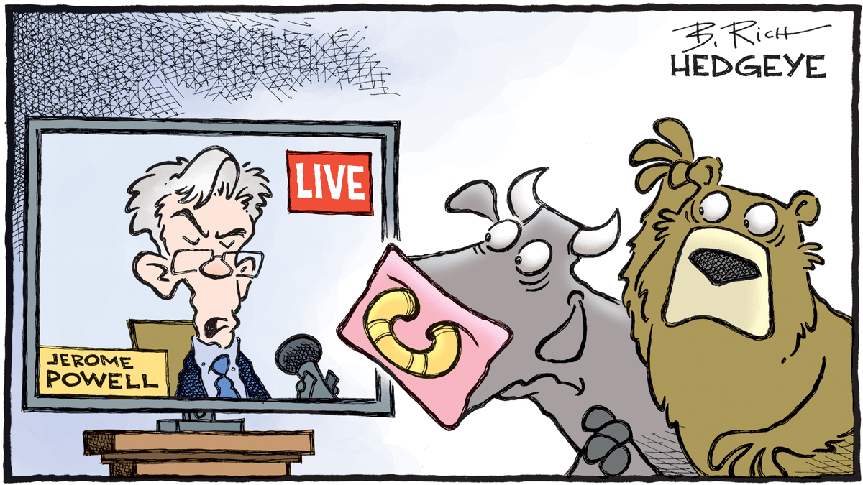
Why we care about the FED!

Slide 4
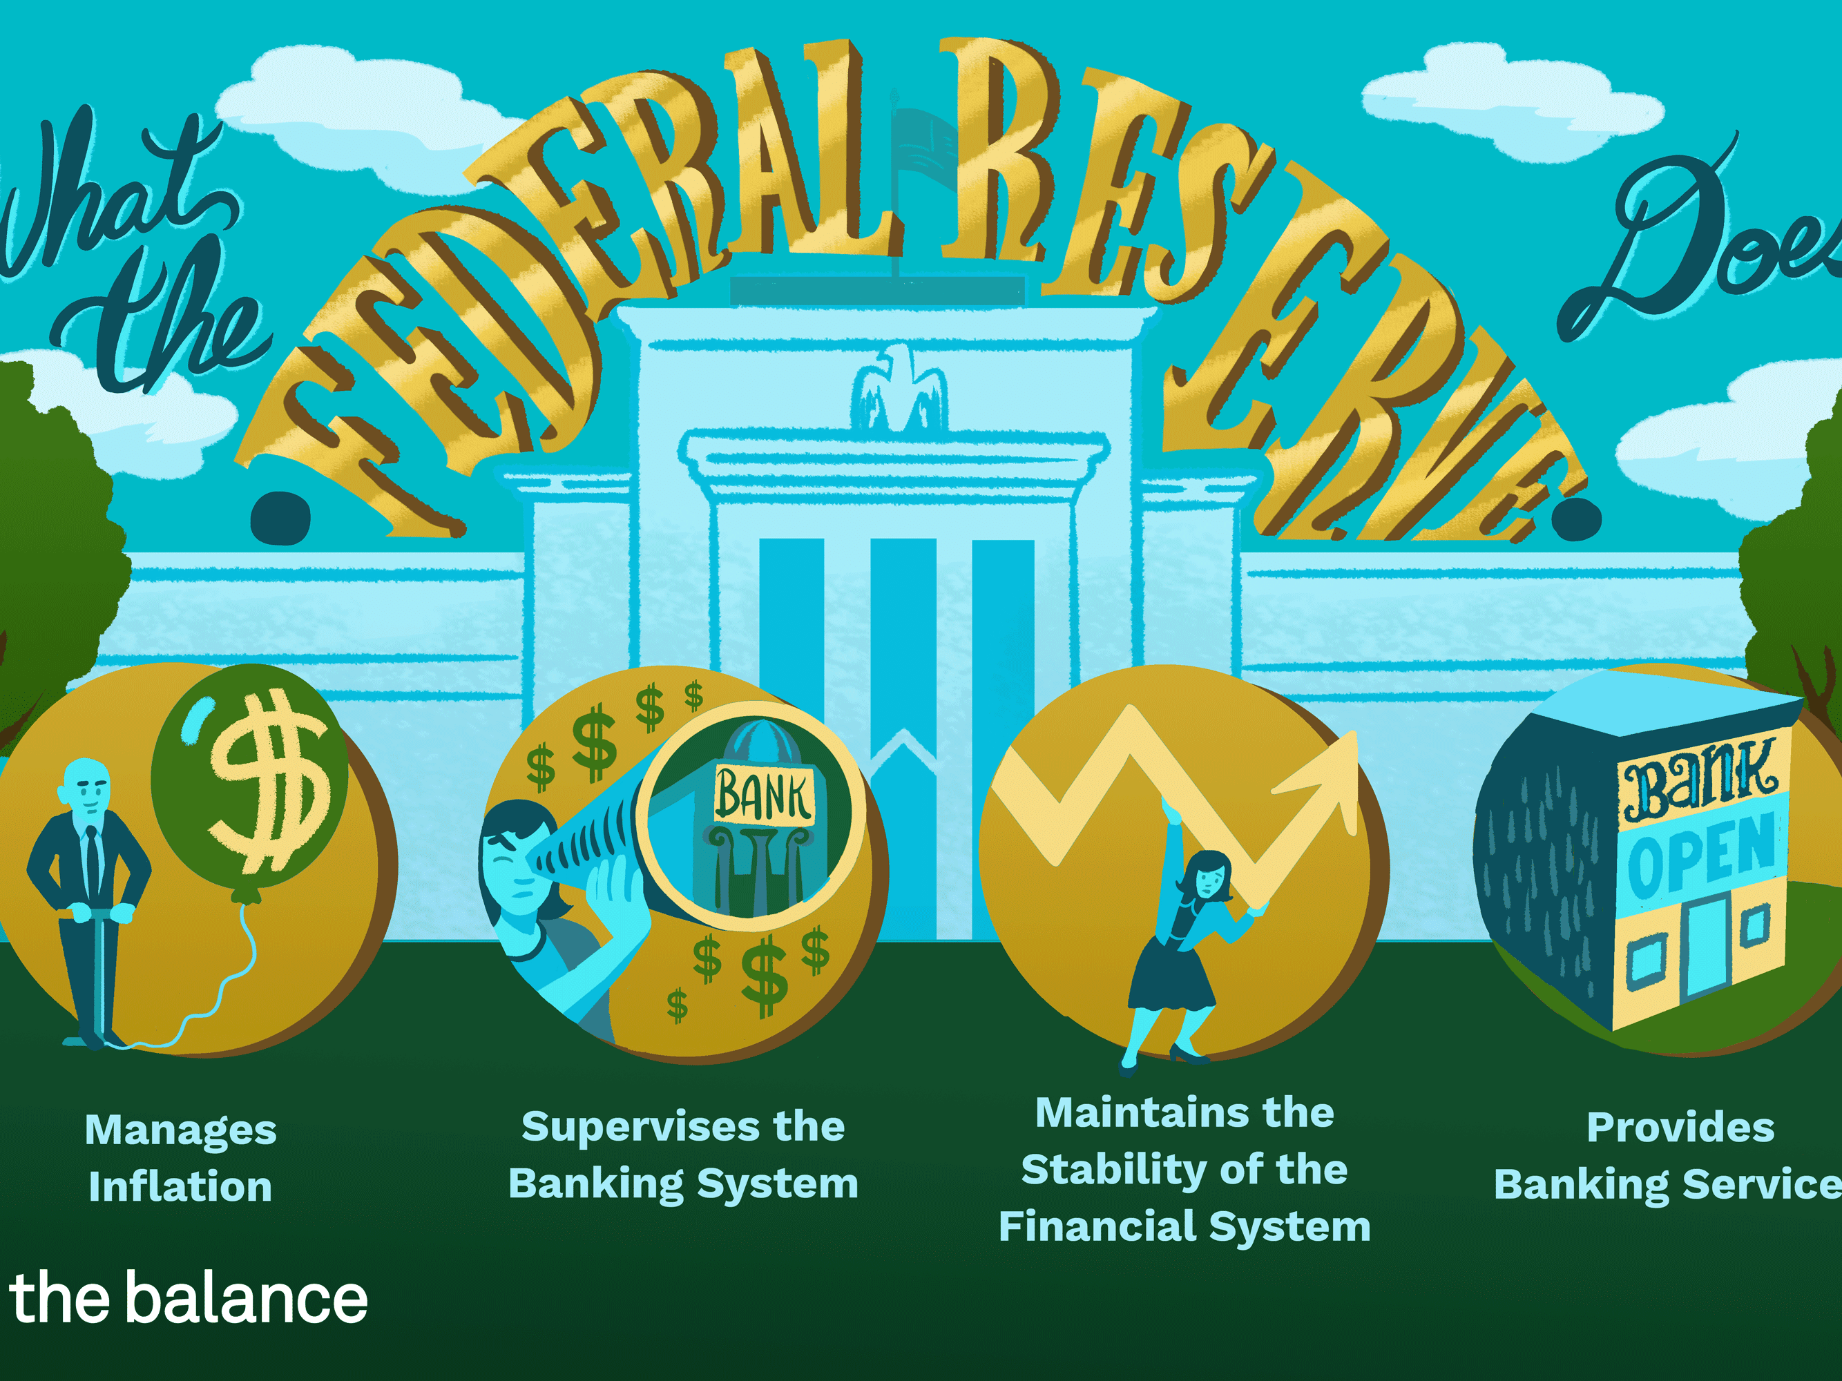
The FED
I. Federal Reserve System – created in 1913
A. Make banks hold adequate reserves
B. Banks must let regulators inspect their accounts
http://www.chicagofed.org/webpages/utilities/about_us/what_we_do.cfm

Slide 5
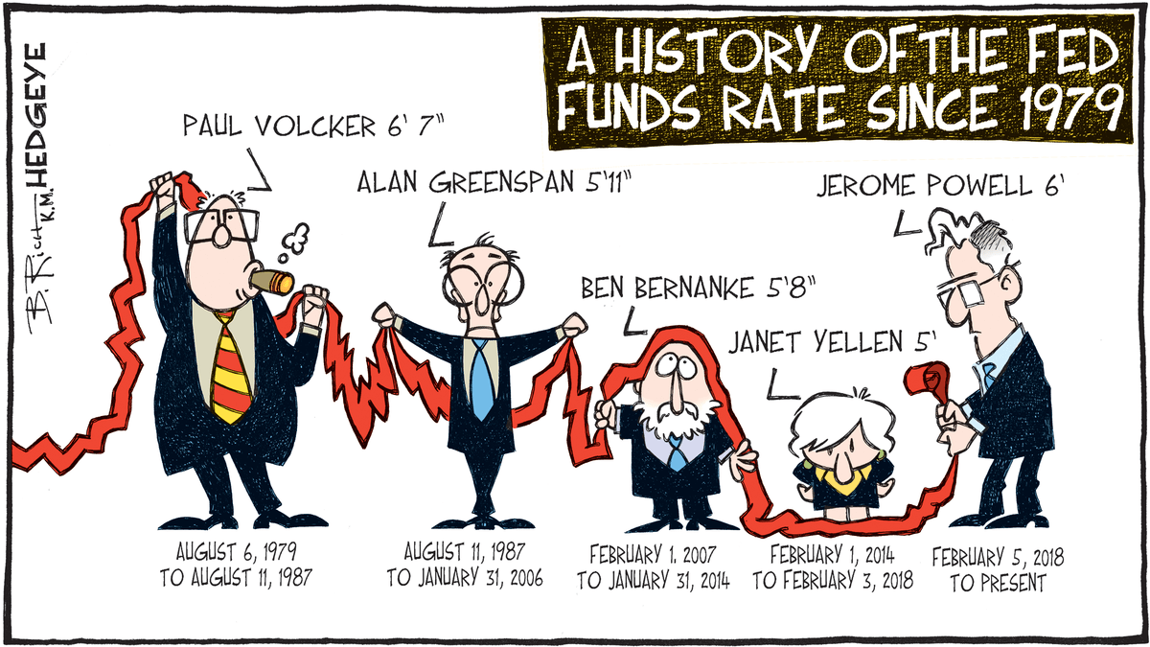
II. Structure
A. Chairman – Jerome Powell
1. Appointed every four years – may be reappointed “several” times

Slide 6
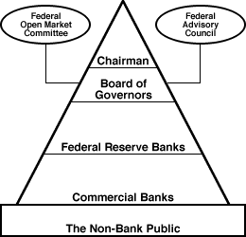
II. Structure
A. Chairman – Jerome Powell
B. Board of Governors
1. 7 members
2. Appointed by the President - cannot be reappointed
3. 14 year terms insulates them from politics

Slide 7
II. Structure
A. Chairman – Jerome Powell
B. Board of Governors
C. FOMC – Federal Open Market Committee
1. Meets 8 times a year
2. Determines if treasury bonds will be bought or sold

Slide 8
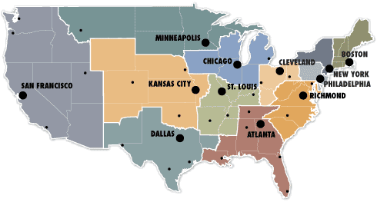
D. 12 Federal Reserve Banks
1. serve a region of the U.S.
2. provide banking supervisory service

Slide 9
