Slide 1
II. Business Cycle – alternating rises and declines in economic activity

Slide 2
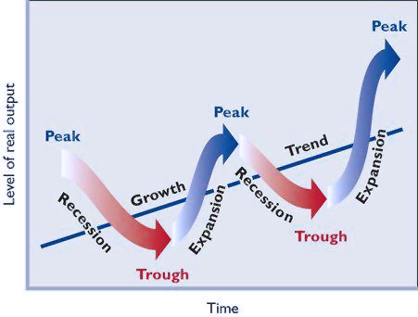
II. Business Cycle – alternating rises and declines in economic activity
A. Peak – business activity has reached a temporary maximum
B. Recession – decline in total output, income, employment, and trade
C. Trough – output and employment are at their lowest levels
D. Recovery – output and employment rise toward full employment

Slide 3
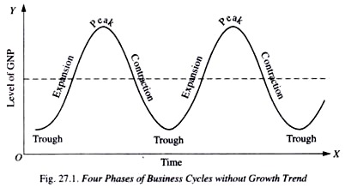
Diagrams can be labeled different ways.

Slide 4
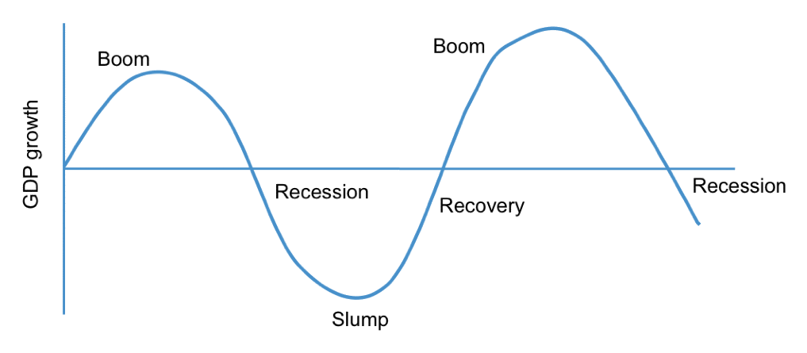

Slide 5
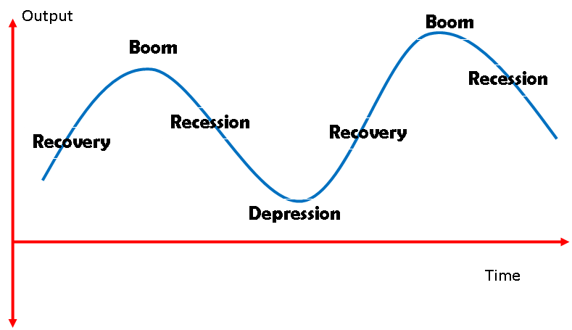

Slide 6
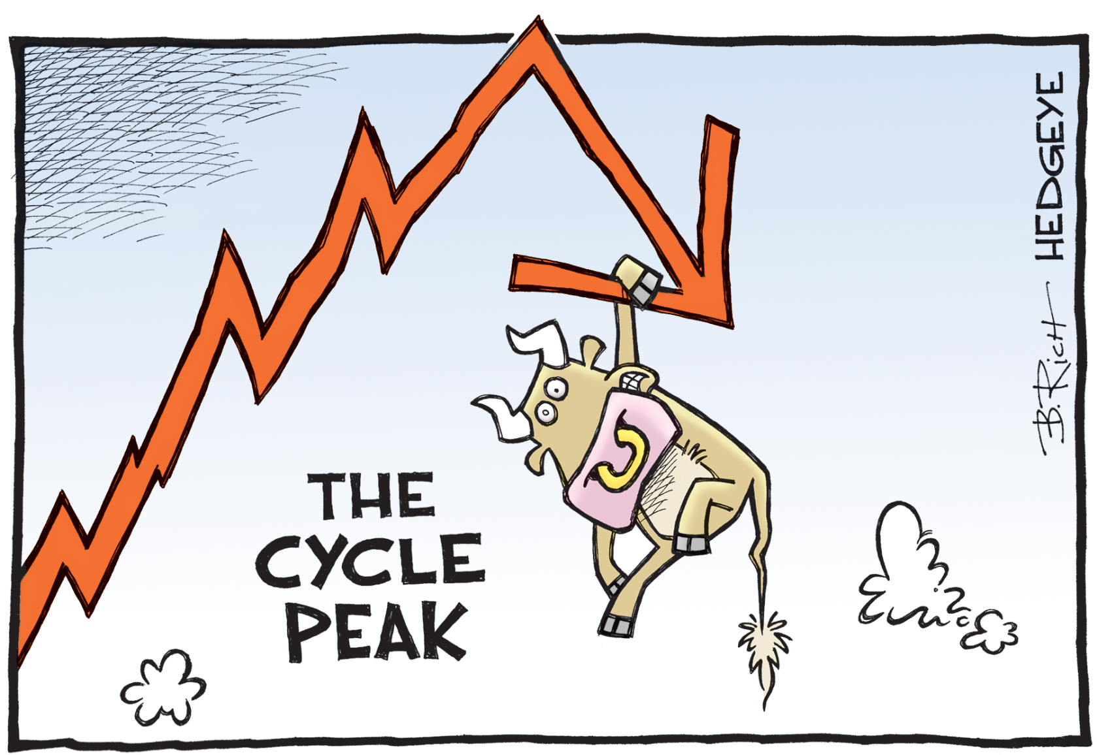
How cartoonists see the business cycle

Slide 7
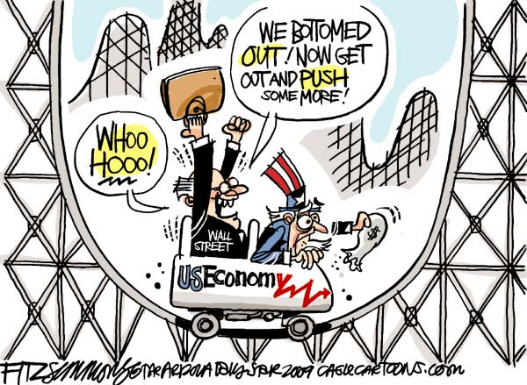

Slide 8
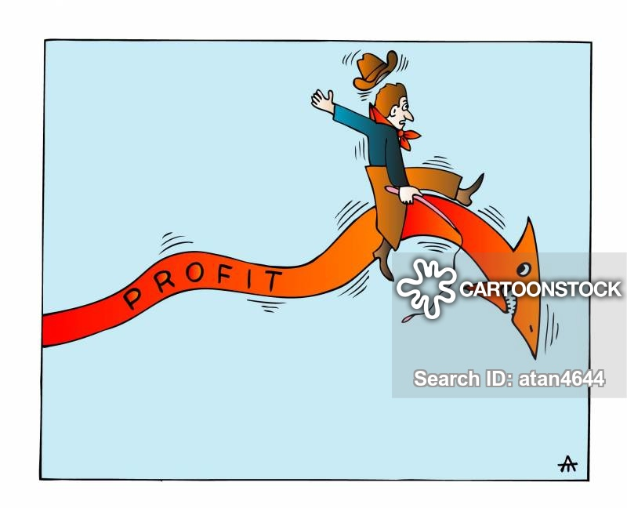

Slide 9
Watch the video to learn about stagflation.

Slide 10
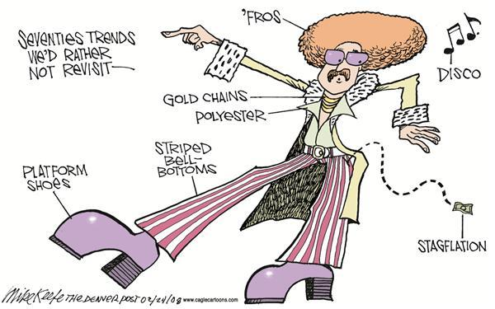
E. Other business cycle measures
1. Stagflation – when inflation and unemployment rise simultaneously
2. Misery Index – a measurement that combines unemployment and inflation

Slide 11
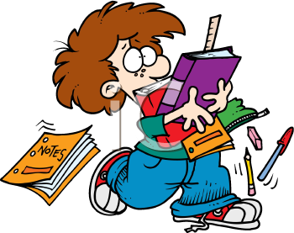
You are ready to do the Circular Flow Model and Business Cycle Homework.

