Slide 1
Banking and The Money Multiplier Notes
2020 version

Slide 2
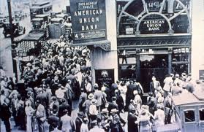
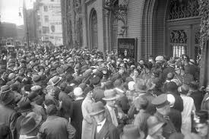
Banking and Money Creation
A. Reserves
1. currency in bank vaults and bank deposits at the FED
2. reserve ratio – fraction of bank deposits that a bank holds
3. required reserve ratio
a. Reserves banks are required by law to hold
b. Prevents a run on the bank
c. Allows FED to control the lending ability of banks
http://vimeo.com/37034368

Slide 3
Banking and Money Creation
A. Reserves
B. Banking regulations protect depositors prevent bank runs
1. FDIC – guarantees depositors the first $250,000
2. Reserve requirements
3. discount window – FED lends money to banks
http://www.youtube.com/watch?v=TAE8i40A5uI

Slide 4
Banking and Money Creation
A. Reserves
B. Banking regulations protect depositors prevent bank runs
C. Banks Create Money
1. banks lend excess reserves
2. money multiplier – indicates the amount of money created by bank loans
Formulas
Money multiplier =
_________1_________
required reserve ratio
excess reserves
OR
amount of first loan
X money multiplier = increase in money supply

Slide 5
Let’s demonstrate how banks create money!

Slide 6
Assume reserve requirements of 20%
All banks should keep the minimum reserve requirement and then pass the excess reserves on to a bank customer in the form of a loan.

Slide 7
$80
Assume the first depositor puts $80 in the bank
First National Bank

Slide 8
First National Bank -- has $80
Remember that reserve requirements are 20%
How much of the $80 are you required to keep as reserves?
How much of the $80 is available to loan?
$16
$64
David Dollars – Comes to ask for a $64 loan and writes First National Bank an IOU.

Slide 9
Bank | Cash | IOU | TOTAL
First National Bank
Second National Bank
Third National Bank
Fourth National Bank
Fifth National Bank
$16
$64
$80
TOTAL $80

Slide 10
$64
David – Spends $64 at the store
$64
Store deposits $64 in the bank
Second National Bank

Slide 11
Second National Bank -- has $64
How much of the $64 are you required to keep as reserves?
How much of the $64 is available to loan?
$13
$51
Michael Money – Comes to ask for a $51 loan and writes Second National Bank an IOU.

Slide 12
Bank | Cash | IOU | TOTAL
First National Bank
Second National Bank
Third National Bank
Fourth National Bank
Fifth National Bank
$16
$64
$80
$13
$51
$64
TOTAL $144

Slide 13
$51
Michael – Spends $51 at the store
$51
Store deposits $51 in the bank
Third National Bank

Slide 14
Third National Bank -- you have $51
How much of the $51 are you required to keep as reserves?
How much of the $51 is available to loan?
$10
$41
Linda Loan – Come ask for a $41 loan and write Third National Bank an IOU.

Slide 15
Bank | Cash | IOU | TOTAL
First National Bank
Second National Bank
Third National Bank
Fourth National Bank
Fifth National Bank
$16
$64
$80
$13
$51
$64
$10
$41
$51
TOTAL $195

Slide 16
$41
Linda – Spends $41 at the store
$41
Store deposits $41 in the bank
Fourth National Bank

Slide 17
Fourth National Bank -- you have $41
How much of the $41 are you required to keep as reserves?
How much of the $41 is available to loan?
$8
$33
Paul Poorman – Come ask for a $33 loan and write Fourth National Bank an IOU.

Slide 18
Bank | Cash | IOU | TOTAL
First National Bank
Second National Bank
Third National Bank
Fourth National Bank
Fifth National Bank
$16
$64
$80
$13
$51
$64
$10
$41
$51
$8
$33
$41
TOTAL $236

Slide 19
$33
Paul – Spends $33 at the store
$33
Store deposits $33 in the bank
Fifth National Bank

Slide 20
Bank | Cash | IOU | TOTAL
First National Bank
Second National Bank
Third National Bank
Fourth National Bank
Fifth National Bank
$16
$64
$80
$13
$51
$64
$10
$41
$51
$8
$33
$41
$33
$33
TOTAL $268

Slide 21
How much money would be added to the money supply if we kept this cycle going?
Multiplier = 1/rr = 1/.2 = 5
64 x 5 = $320

Slide 22
How much money would be added to the money supply if we kept this cycle going?
Multiplier = 1/rr = 1/.2 = 5
64 x 5 = $320
Money created by the banking system
Excess
Reserves
OR
First Loan

Slide 23
How much money would be added to Bank deposits if we kept this cycle going?

Slide 24
How much money would be added to Bank deposits if we kept this cycle going?
$320 + $80 = $400
Money created by the banking system
Money I originally deposited

Slide 25
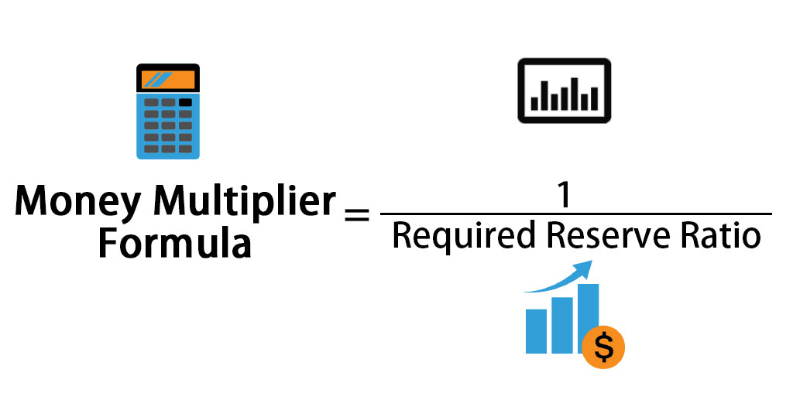
https://www.youtube.com/watch?v=JG5c8nhR3LE

Slide 26
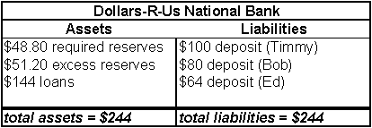
Bank T accounts
A. Financial spreadsheet that displays an institution’s financial position
B. Assets
1. economic resources, things of value
2. on the left side of the T-account
C. Liabilities
1. debts
2. on the right side of the T-account

Slide 27
Work through this example:
Suppose Narvaizville has a single bank that has:
$20,000 of deposits
$4000 of reserves
$16,000 of loans
Narvaizville’s central bank has 10% reserve requirement.
Construct a T-account depicting this situation. Make sure you:
differentiate between required and excess reserves
Have assets equal to liabilities.
Assets
Liabilities
Required Reserves $2,000
Excess Reserves $2,000
Loans $16,000
Deposits $20,000
Assets and Liabilities must be equal --- Are they?

Slide 28
Work through this example:
Remember the reserve requirement is 10%
What is the multiplier ?
1/rr = 1/.1 = 10
Assets
Liabilities
Required Reserves $2,000
Excess Reserves $2,000
Loans $16,000
Deposits $20,000

Slide 29
Work through this example:
Suppose the bank in Narvaizville lends all its excess reserves (the amount you calculated in the previous problem) until it reaches the point where its excess reserves equal zero.
How much additional money will the bank lend out?
$2,000
How much money will this additional lending add to the money supply?
$2,000 x 10 (multiplier) = $20,000

Slide 30
Work through this example:
How much money will this additional lending add to the money supply?
$2000 x 10 (multiplier) = $20,000
Assume that all of the money that is created will be deposited in the bank and that the bank will loan out all excess reserves. Create a t-account that shows this.
Assets
Liabilities
Required Reserves $2,000
Excess Reserves $2,000
Loans $16,000
Required Reserves $4,000
Deposits $20,000
Deposits $40,000
Excess Reserves $0
Loans $36,000

Slide 31
Work Money Multiplier Example now!

