Slide 1
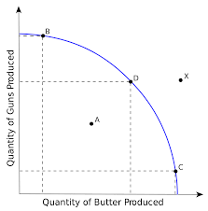
How would you describe the shift shown in the diagram?
What does point A in the diagram represent?
What point in the diagram represents efficient production?
Inefficiency – production at this point does not use all resources
B, c or D are all efficient
Change (Decrease) in demand
What are the factors of production?
Land, labor, capital and entrepreneurial ability
What is the law of increasing costs?
As more of a good is produced, there is an increasing opportunity cost.
What causes a change in quantity demanded?
Change in price.
How is a change in quantity demanded depicted on a demand curve?
A movement along the demand curve
What will happened to the demand for a good if the price of a substitute increases?
Demand increases
What will happen to the demand for a good if the price of a compliment increases?
Demand decreases

Slide 2
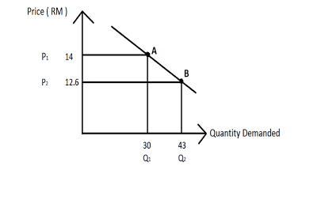
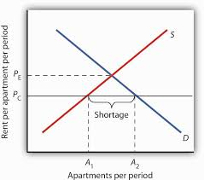
How would you describe the line labeled Pc in the diagram?
How would you describe the shift shown in the diagram?
How would you describe the movement along the demand curve from point A to point B?
Change in supply – increase in supply
Change in quantity demanded
Price ceiling
Where is a price ceiling usually set?
Below equilibrium
Where is a price floor usually set?
Above equilibrium.
What problem does a price ceiling usually cause?
shortage.
What problem does a price floor usually cause?
surplus
What is the formula for GDP?
GDP = C + I + G + (X-m)
What is the major difference between nominal GDP and real GDP?
Real GDP is adjusted to take inflation into account

Slide 3
In the circular flow model who are the owners of the factors of production?
What is the equilibrium price in the diagram?
What problem does our economy have if it is producing at point A?
P2
recession
Households
What exchanges happen in the product market of the circular flow diagram?
Firms sell the products the produce to households who are the buyers in the product market
What is an intermediate good?
A good that is used in the production of a final good
What is stagflation?
A situation where there is both high unemployment and high inflation
What are discouraged workers?
Persons who are unemployed but no longer looking for work. They are not in the labor force
What does Marginal Propensity to consume measure?
The amount of an increase in income that would be spent
What is the formula for the spending multiplier?
1/MPS

Slide 4
If MPC is .7 what is the MPS?
IF MPC is .7 what is the spending multiplier?
What is the Formula for AD?
.3
3.333333
GDP = C + I + G + (X-m)
If MPC is .7 and government spending increases by $5 million what will happen to Real GDP?
Increase by $16.5 million
If MPS is .25 what is the spending multiplier?
4
Explain what the multiplier effect is?
Any change in spending creates an even bigger change in GDP
If investment spending increases by $10 million what will happen to the AD curve?
It will shift right – we don’t know how much unless we know the multiplier
When short run equilibrium is to the right of the LRAS what kind of gap is created?
inflationary
When short run equilibrium is to the left of LRAS what kind of gap is created?
recessionary

Slide 5
If the FED increases interest rates what are they trying to do?
What are three things the FED can do to control the economy?
What does the aggregate supply curve look like in the long run?
Raise and lower reserve requirement
Raise and lower the discount rate
Buy or sell government bonds
Contract the economy or fight inflation
vertical
What is crowding out?
When Government investment increases and “crowds” private investment out of the market. There is less private investment
What can the Fed do to expand the economy?
Reduce reserve requirements
Lower the discount rate
Buy government bonds
What happens to the money supply when the FED sells government securities?
decreases
If Susan deposits $100 in her checking account, how much has that action alone changed the money supply?
No change
If the reserve requirement is 20% and the bank has $100 of excess reserves, how much can they lend out initially?
$80
If the reserve requirement is 20% and there are $100 of excess reserves in the banking system. How much can the money supply expand?
$500

Slide 6
What two things can the government do that would be considered fiscal policy?
According to the short run Phillips curve, if there is low unemployment what will inflation be like?
What if the federal funds rate?
Raise/lower taxes
Increase/decrease government spending
The interest rate banks charge to one another
Inflation will be high
What type of fiscal policy should the government pursue to fight inflation?
Raise taxes
Lower spending
How will an increase in government spending effect AD?
AD will increase
What types of fiscal policy are considered contractionary?
Increase taxes
Decrease spending
What types of fiscal policy are considered expansionary?
Decrease taxes
Increase spending
If the U.S. dollar depreciates relative to the Euro, what will happen to Us goods sold in Europe?
They become cheaper
If the US has a strong dollar what effect will it have on tourism?
Foreign tourists coming to the U.S. will have to spend more money for their trip

